Slide 1

SETDAB World Cup Communications 2026
The SETDAB partnership has worked collaboratively to develop this toolkit to raise awareness of the link between football and domestic abuse.
Our aim is to ensure more people understand that incidents can increase during major tournaments and signpost to support.
If you are a voluntary or statutory organisation in Essex, Thurrock or Southend, and share our vision “to enable everyone to live a life free from all forms of domestic abuse,” we encourage you to share this campaign across your channels.
You are welcome to adapt the content to reflect your own branding and style. However, we ask that all content signposts to Compass, the Essex-wide domestic abuse helpline.
To support monitoring and evaluation, please include the campaign hashtag #AbuseOffside in your posts.
For further information or advice about any of the resources included, please contact:
domestic.abuseessex@essex.gov.uk

Slide 2
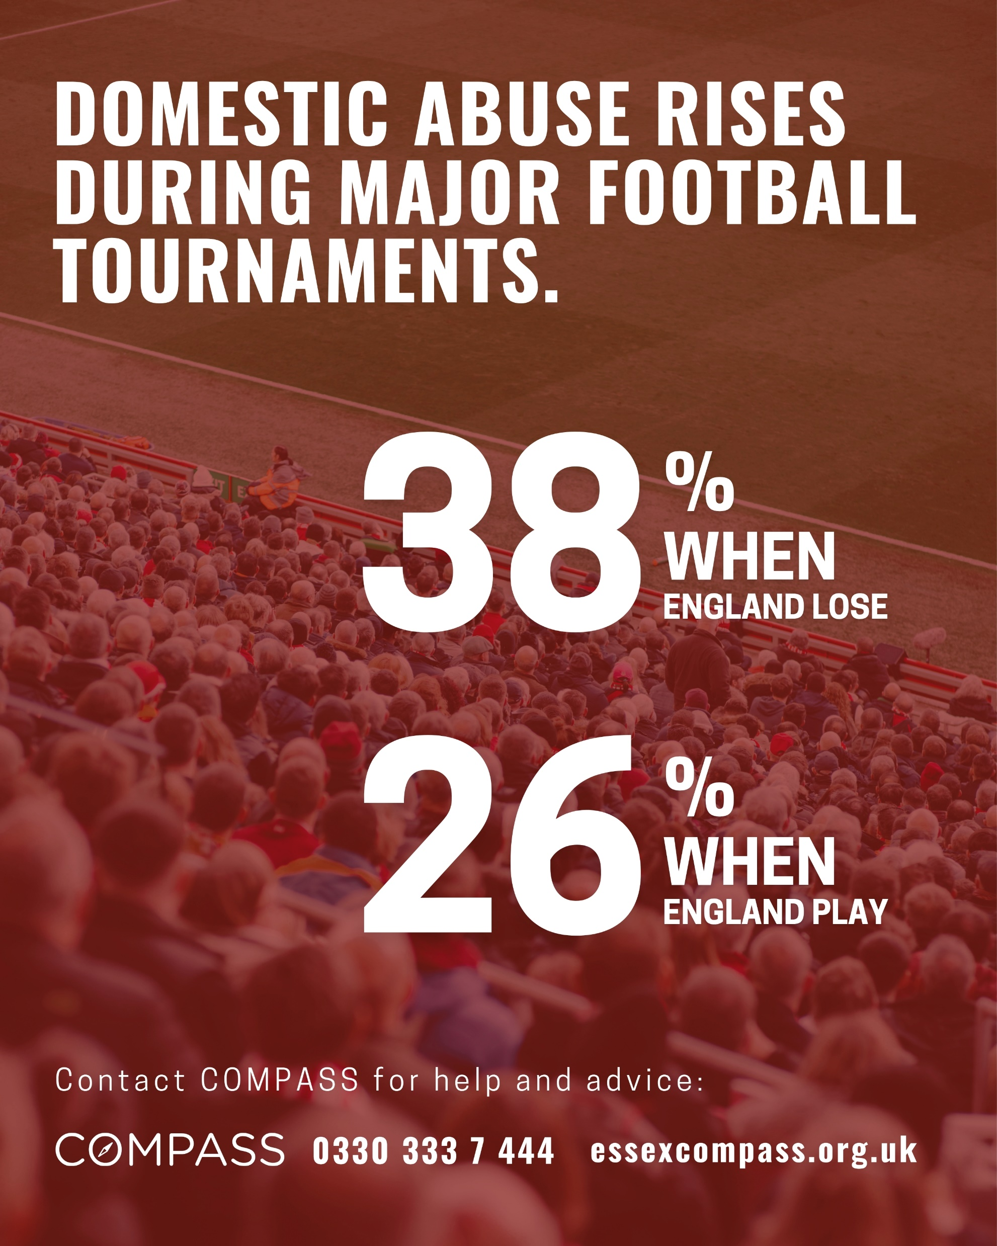
General awareness
Football should never be an excuse for abuse.
Evidence shows domestic abuse rises during major football tournaments, with incidents increasing by 38% when England lose and 26% when England play.
This isn’t just a statistic. It’s a reality for too many people.
If you’re worried about someone, or need support yourself, help is available.
Compass is our Domestic Abuse helpline for Essex call 0330 333 7 444 or visit essexcompass.org.uk
#AbuseOffside

Slide 3

Survivor/Bystander Focus
For people in abusive relationships, football tournaments can make things worse. Alcohol, drugs and gambling can increase risk, but they are never an excuse.
Everyone should feel safe at home, during the match and every day after.
If you’re worried about someone, or need support yourself, help is available.
Call Compass our Domestic Abuse helpline for Essex on 0330 333 7 444 or visit essexcompass.org.uk
#AbuseOffside

Slide 4

Survivor Focus
Win, lose or draw, abuse is never your fault.
Football tournaments can make things worse. Alcohol, drugs and gambling can increase risk, but they are never an excuse.
If you’re worried about how the result might affect you, support is available. You are not alone.
Call Compass our Domestic Abuse helpline for Essex on 0330 333 7 444 or visit essexcompass.org.uk
#AbuseOffside

Slide 5

People causing harm
A tough result is not an excuse for abuse.
If you feel your anger rising after the game, stop and take a step back.
Support is available to help you understand and change your behaviour.
Abuse is a choice, and you can choose to change.
If you or someone you know needs help to change contact Compass on 0330 333 7 444 or visit essexcompass.org.uk/reflect-reset/
#AbuseOffside

