Slide 1


SETDAB campaign toolkit for
National Stalking Awareness Week
20 to 26 April 2026
Campaign Theme: emphasising the critical link between stalking and homicide
Link: Save The Date: National Stalking Awareness Week | Suzy Lamplugh Trust

Slide 2
Stalking is a recognised high‑risk behaviour that can escalate rapidly to serious harm, including domestic abuse homicide. Research shows that the period after a relationship end is often the most dangerous, with stalking frequently used to regain control.
Stalking should be taken seriously, and this pack aims to help people understand the different types of stalking, recognise early warning signs, and know where to go for support and safety.
Usage guidelines
We request that no images, graphics, or calls to action within this media pack be altered, edited, or modified in any way.
Where possible please use the link below for Compass, so we can track engagement.
https://www.essexcompass.org.uk/?utm_source=website&utm_medium=referral&utm_campaign=stalking_campaign
For further information or advice about any of the resources included in this toolkit, please contact domestic.abuseessex@essex.gov.uk

Slide 3

Suggested content:
We are supporting the Suzy Lamplugh Trust’s National Stalking Awareness Week, 20 to 26 April.
Stalking after a relationship has ended is when a former partner engages in a pattern of fixated, obsessive, unwanted and repeated behaviour that causes fear or distress.
It can include anything from non-stop calls and text messages, unwanted gifts, monitoring you online, turning up at your home or workplace, following you, damaging your property, or using friends, children or family members to make contact.
If you think you are being stalked by a former partner, trust your instincts and please reach out for help through Compass, call 0330 333 7 444 or visit their website for assistance.
Please use this link to compass so we can track engagement:
https://www.essexcompass.org.uk/?utm_source=website&utm_medium=referral&utm_campaign=stalking_campaign
#NSAW2026 #StalkingAwareness #SETDAB
Right click on image to save and use

Slide 4
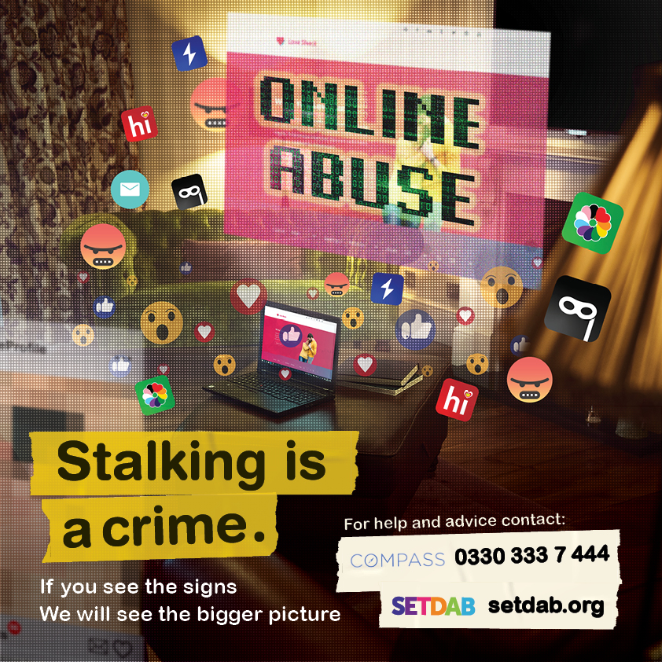
Suggested content:
Is your ex-partner keeping track of you online or using other electronic means to harass, scare, or threaten physical harm. This is Cyber Stalking and it’s a crime.
What can you do?
Be mindful of what you share online
Regularly check and update your privacy settings on social media platforms
Regularly change passwords
Turn off location tagging on posts
Keep a record, screen shot or log of calls and text messages
Read Hayley's story to understand how stalking affected her life.
A Stalking Case Study - Hayley’s online stalking nightmare - Southend and Thurrock Domestic Abuse Partnership (setdab.org)
If you see the signs Compass can help. Call 0330 333 7 444 or visit their website for assistance essexcompass.org.uk
#NSAW2026 #StalkingAwareness #SETDAB
Right click on image to save and use

Slide 5

Suggested content:
Cyberstalking by an ex‑partner can include unauthorised access to or manipulation of smart home devices, such as Alexa, heating systems or smart locks. Find out more how to protect yourself by visiting
Get Safe Online | The UK's leading Online Safety Advice Resource
Stalking after a relationship has ended, is a pattern of persistent, unwanted attention that can leave you feeling scared, anxious or harassed. You are not alone, please reach out for help through Compass, call 0330 333 7 444 or visit their website essexcompass.org.uk
#NSAW2026 #StalkingAwareness #SETDAB
Right click on image to save and use

Slide 6
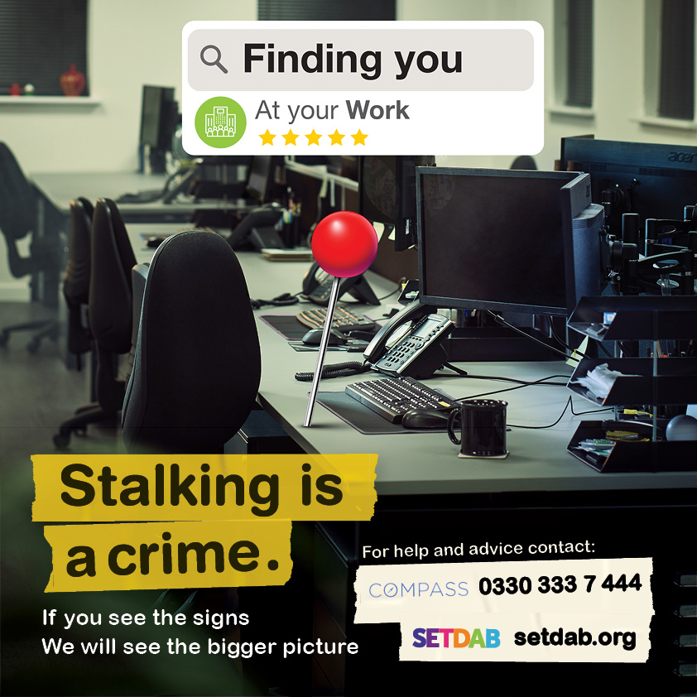
Suggested content:
Is your ex-partner following you, turning up at your work, or constantly contacting you? Are you changing your daily routine or route to work to avoid them?
Read Rosie's story to understand how stalking affected her life
If you think you’re being stalked by a former partner, there is help available through Essex Compass, call 0330 333 7 444 or visit their website essexcompass.org.uk
Trust your instincts and get the help you need today.
#NSAW2026 #StalkingAwareness #SETDAB
Right click to save picture and use

Slide 7

Suggested content:
Is your ex bombarding you with unwanted texts, emails or messages? Is the constant unwanted contact making you feel overwhelmed, uncomfortable or frightening you?
Stalking after a relationship has ended poses a real threat of harm. Trust your instincts and please reach out for help through Compass, call 0330 333 7 444 or visit their website essexcompass.org.uk
Where possible please use this link to compass so we can track engagement:
https://www.essexcompass.org.uk/?utm_source=website&utm_medium=referral&utm_campaign=stalking_campaign
#NSAW2026 #StalkingAwareness #SETDAB
Right click on image to save and use

Slide 8

Suggested content:
Feeling like your controlling ex-partner is everywhere you go? Whether it's the bar, supermarket, gym, or even your GP. Could they be tracking you via your phone or an apple tag?
Stalking after a relationship has ended poses a real threat of harm. Trust your instincts and please reach out for help through Compass, call 0330 333 7 444 or visit their website essexcompass.org.uk
Where possible please use this link to compass so we can track engagement:
https://www.essexcompass.org.uk/?utm_source=website&utm_medium=referral&utm_campaign=stalking_campaign
#NSAW2026 #StalkingAwareness #SETDAB
Right click on image to save and use

Slide 9
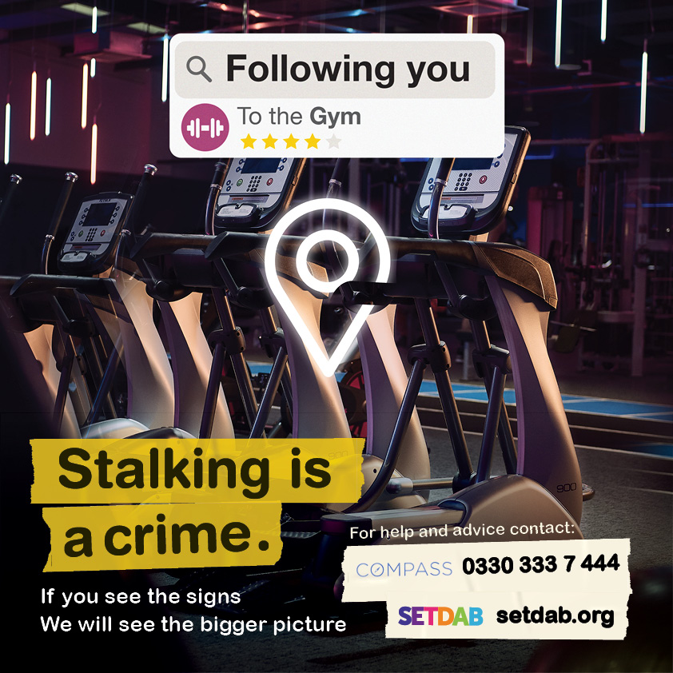
Suggested content:
Feeling like your controlling ex-partner is everywhere you go? Whether it's the bar, supermarket, gym, or even your GP. Could they be tracking you via your phone or an apple tag?
Stalking after a relationship has ended poses a real threat of harm. Trust your instincts and please reach out for help through Compass, call 0330 333 7 444 or visit their website essexcompass.org.uk
Trust your instincts and get the help you need today.
Where possible please use this link to compass so we can track engagement:
https://www.essexcompass.org.uk/?utm_source=website&utm_medium=referral&utm_campaign=stalking_campaign
#NSAW2026 #StalkingAwareness #SETDAB
Right click on image to save and use

Slide 10
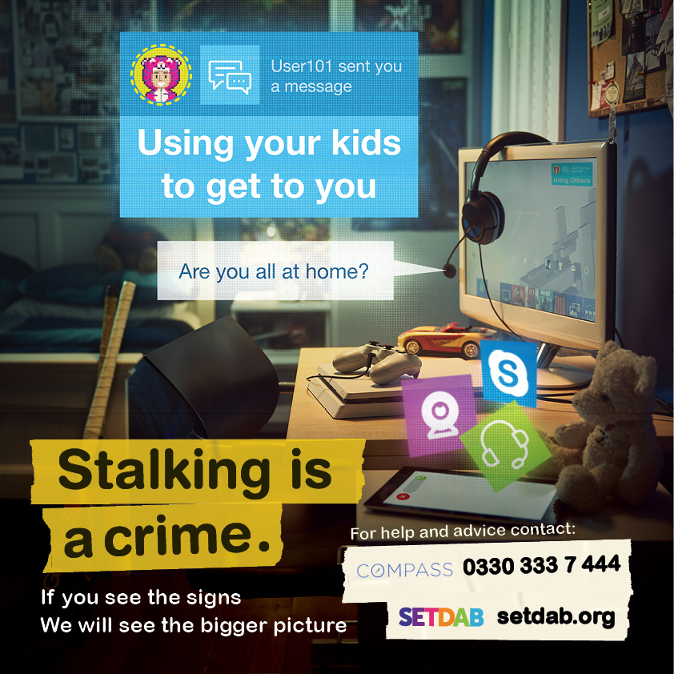
Suggested content:
Is your ex-partner using your kids or family members to get to you, threaten you or find out information about you?
Maybe they are turning up at the school gates and using the school in some way to get to you. Is their obsessive behaviour causing you distress? Stalking can have a huge impact on you and your family.
If you think you’re being stalked by a former partner, there is help available through Compass, call 0330 333 7 444 or visit their website essexcompass.org.uk.
Trust your instincts and get the help you need today.
Where possible please use this link to compass so we can track engagement:
https://www.essexcompass.org.uk/?utm_source=website&utm_medium=referral&utm_campaign=stalking_campaign
#NSAW2026 #StalkingAwareness #SETDAB
Right click on image to save and use

Slide 11
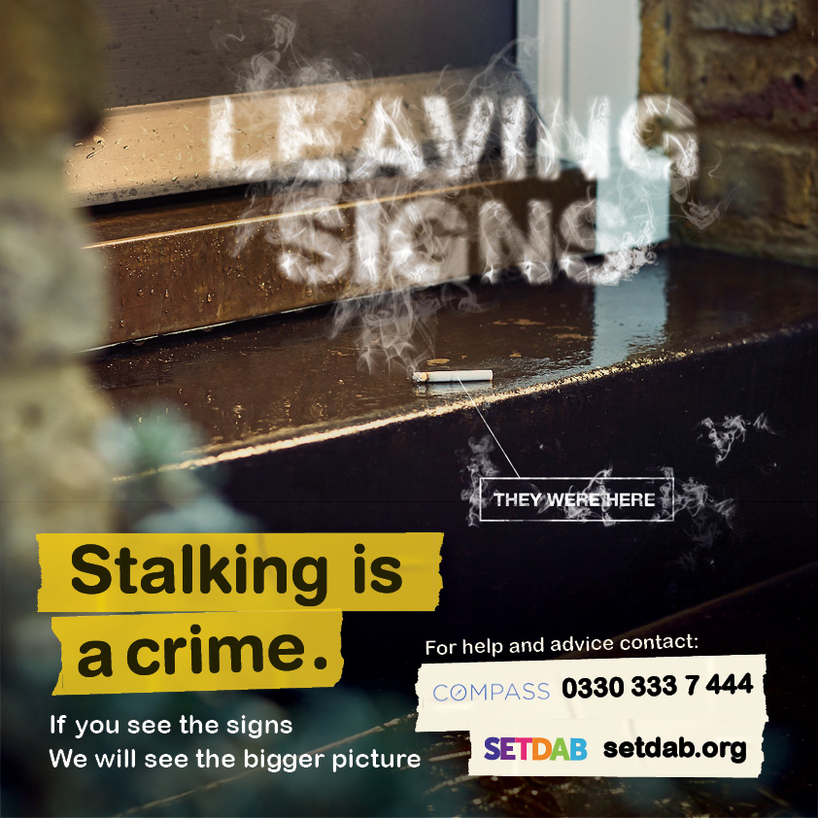
Suggested content:
Is your ex-partner leaving subtle signs to let you know that they have ‘been there’? Unlike other crimes, which usually involve one act, stalking is a series of actions that occur over time, from unwanted contact to following and tracking you.
If you suspect you are being stalked by an ex-partner, Compass is here to help. Call 0330 333 7 444 or visit their website for assistance.
Where possible please use this link to compass so we can track engagement:
https://www.essexcompass.org.uk/?utm_source=website&utm_medium=referral&utm_campaign=stalking_campaign
#NSAW2026 #StalkingAwareness #SETDAB
Right click on image to save and use

Slide 12

Suggested Content
Is the damage to your property an isolated incident or is it part of a bigger picture? Unlike other crimes, which usually involve one act, stalking is a series of actions that occur over time.
Abuse doesn’t always end when the relationship ends. Help is available and you will be believed and supported.
If you suspect you're being stalked by an ex-partner, reach out for support. Compass is here to help. Call 0330 333 7 444 or visit their website essexcompass.org.uk for assistance.
Where possible please use this link to compass so we can track engagement:
https://www.essexcompass.org.uk/?utm_source=website&utm_medium=referral&utm_campaign=stalking_campaign
#NSAW2026 #StalkingAwareness #SETDAB
Right click on image to save and use

Slide 13
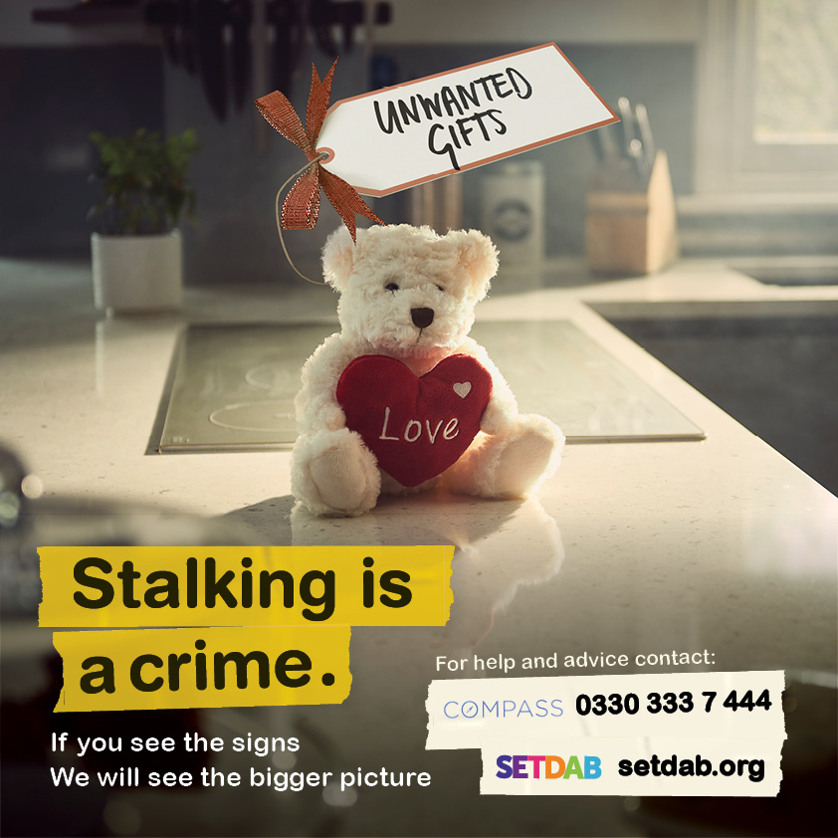
Suggested content
Is your ex-partner sending you unwanted gifts or deliveries? Are you feeling uneasy about the unwanted attention or feeling threatened and frightened?
Stalking after a relationship has ended, is a pattern of persistent, unwanted attention that can leave you feeling scared, anxious or harassed. You are not alone, please reach out for help through Compass, call 0330 333 7 444 or visit their website essexcompass.org.uk
Where possible please use this link to compass so we can track engagement:
https://www.essexcompass.org.uk/?utm_source=website&utm_medium=referral&utm_campaign=stalking_campaign
#NSAW2026 #StalkingAwareness #SETDAB
Right click on image to save and use

Slide 14
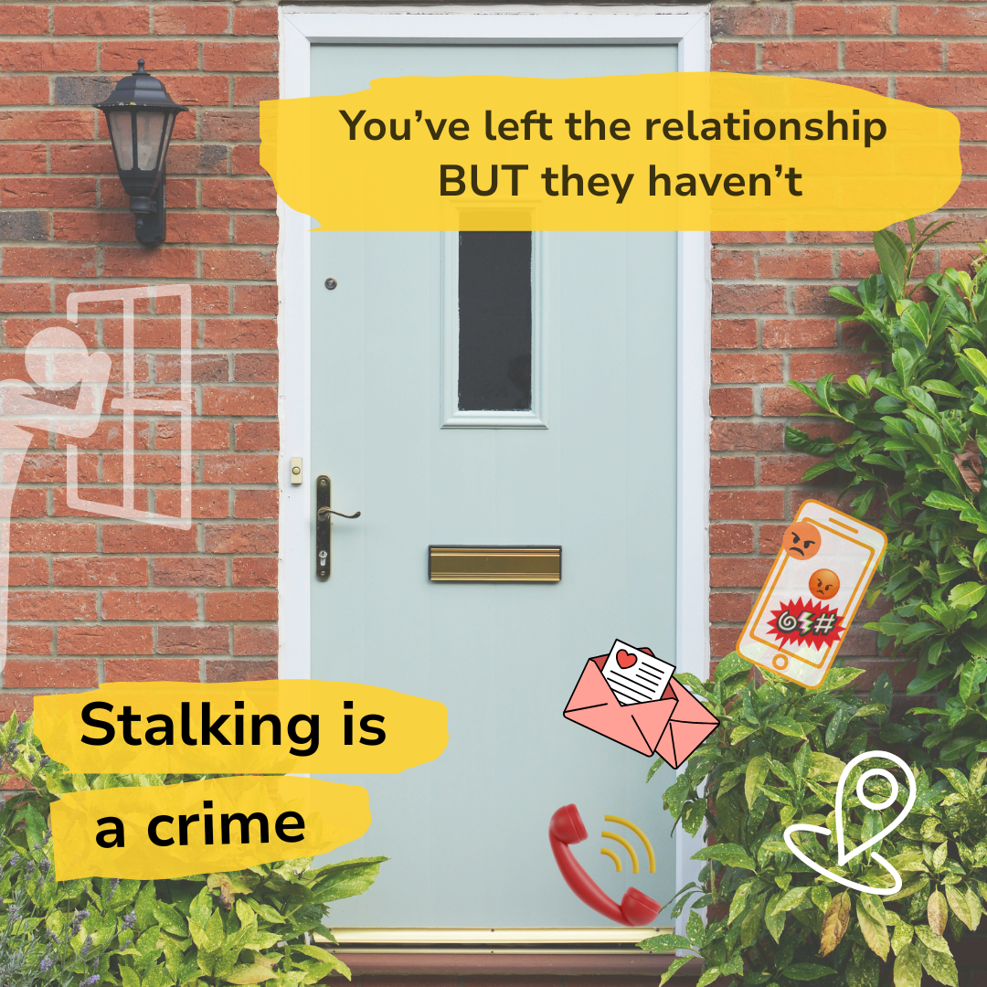
Suggested content
Is your ex-partner making unwanted content such as repeatedly turning up at your home or sending you letters through the post.
Are you constantly looking over your shoulder, and feeling isolated or unsafe in your own home?
Stalking by a former partner, is a pattern of persistent, unwanted attention that can leave you feeling scared, anxious or harassed. You are not alone, and support is available.
If you’re worried about someone (or yourself), please contact Compass on 0330 333 7 444 or visit essexcompass.org.uk
Please use this link to compass so we can track engagement:
https://www.essexcompass.org.uk/?utm_source=website&utm_medium=referral&utm_campaign=stalking_campaign
#NSAW2026 #StalkingAwareness #SETDAB
Right click on image to save and use

Slide 15

MP4 video social media reel
Right click on image,
“pick save media as”
Share as a reel or story

Slide 16
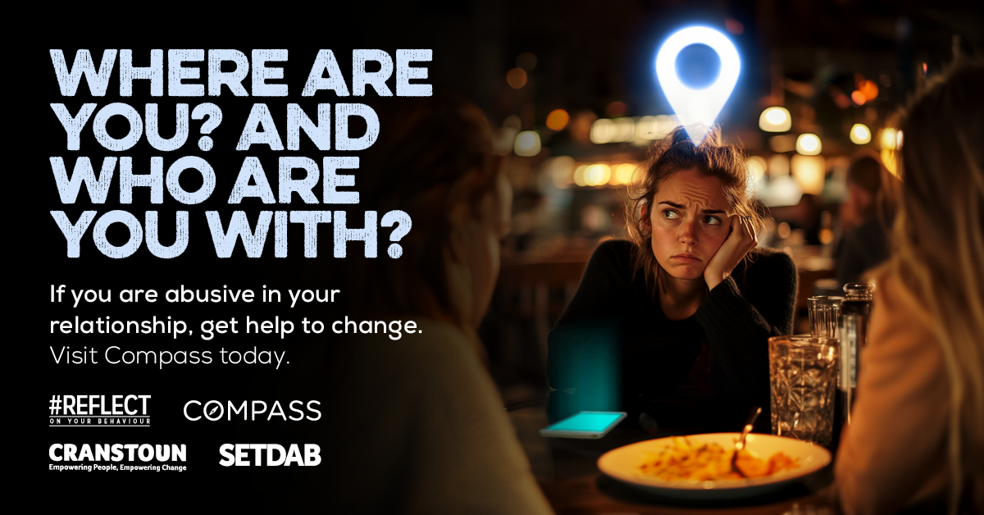
Suggested content for people causing harm
You don’t need to ‘check on them’
Monitoring an ex-partner's location, demanding updates, or turning up uninvited is stalking and harassment.
If this sounds like you, it’s time to #REFLECT and stop before it escalates. Take responsibility and get help to change.
Support is available via Essex Compass.
Call 0330 333 7 444 or visit their website (link in comments)
Please use this link to compass so we can track engagement:
https://www.essexcompass.org.uk/reflect-reset/#reflect-reset?utm_source=website&utm_medium=referral&utm_campaign=stalking_campaign
#NSAW2026 #StalkingAwareness #SETDAB
Right click on image to save and use

Slide 17
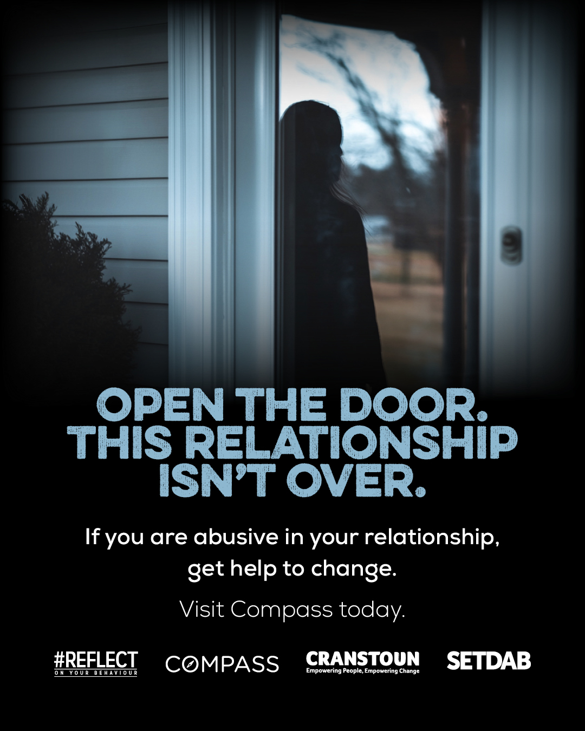
Suggested content for people causing harm
Spending all your time tracking your ex-partner’s movements? Maybe you turned up at their house when they didn’t want you there, or sent hundreds of messages when they didn’t pick up the phone. Are feelings of jealousy taking over your life?
If this sounds like you, it’s time to #Reflect on your behaviour and get help to change. Call Compass today on 0330 333 7 444 or visit their website. (link in comments).
Comments: contact Essex Compass today:
Please use this link to compass so we can track engagement:
https://www.essexcompass.org.uk/reflect-reset/#reflect-reset?utm_source=website&utm_medium=referral&utm_campaign=stalking_campaign
#NSAW2026 #StalkingAwareness #SETDAB
Right click on image to save and use

Slide 18
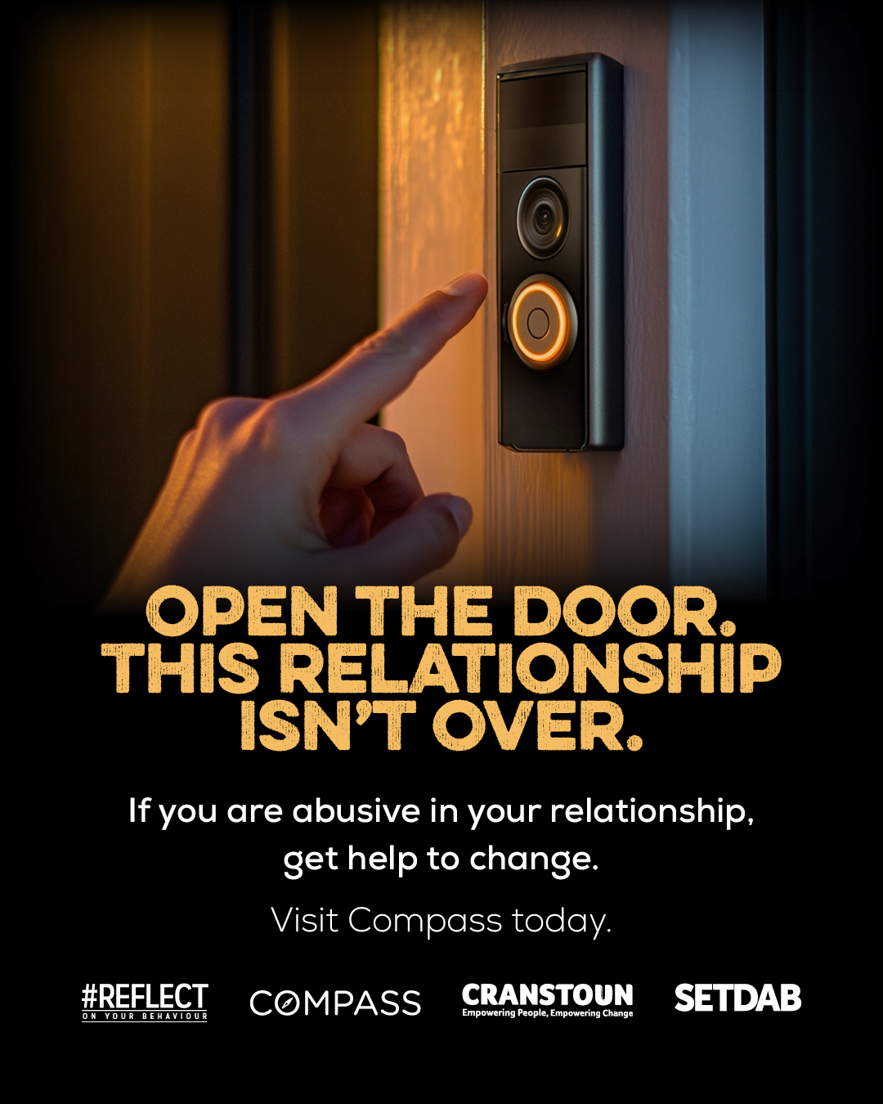
Suggested content for people causing harm
The relationship is over. But for you…it isn’t.
You’re still ‘checking in’, still watching, turning up – even when they’ve asked you not to.
It might feel like concern, but if you’re contacting an ex repeatedly, monitoring where they go or showing up uninvited. That isn’t care. That’s stalking and harassment.
If this sounds like you, it’s time to #Reflect on your behaviour and get help to change. Call Compass today on 0330 333 7 444 or visit their website. (link in comments)
Comments: contact Essex Compass today:
Please use this link to compass so we can track engagement:
https://www.essexcompass.org.uk/reflect-reset/#reflect-reset?utm_source=website&utm_medium=referral&utm_campaign=stalking_campaign
#NSAW2026 #StalkingAwareness #SETDAB
Right click on image to save and use

