Slide 1

Christmas Communications – Behind The Smiles
Developed by the Southend, Essex and Thurrock Domestic Abuse Partnership
Tonic report* findings - January 2023
While definitions of domestic abuse has been expanded under the Domestic Abuse Act (2021), it is still often predominantly associated with physical violence and not well understood by the public. Coercive control and psychological abuse are common factors in many cases and are indicators of high harm. However, these aspects of abuse are less well understood.
*The SETDAB TONIC report is a research project commissioned by the Southend, Essex and Thurrock Domestic Abuse Board (SETDAB) and conducted by TONIC. Its purpose was to gain a deeper understanding of the experiences of individuals affected by domestic abuse and to inform improvements in support systems across the region.
Lived in Experience findings – June 2025
Consultation with our lived experience group tells us that people need a range of communications for different audiences to help understand domestic abuse and the types of abusive behaviours involved.

Slide 2

Audience: friends and family
Behind some smiles, there’s silence. Behind some laughter, there’s fear. Domestic abuse isn’t always physical
Here’s what it can look like:
Gaslighting – Making someone doubt their memory
Monitoring – obsessively checking phones or whereabouts
Verbal abuse – constant criticism or humiliation
Financial control – limiting access to money or work
Threats – using fear to control decisions
Two faces – kind in public, controlling in private
You never know what’s happening behind closed doors.
If you or someone you know needs help, reach out. You are not alone. Call the domestic abuse helpline Essex Compass on 0330 333 7 444 (8.00am to 8.00pm weekdays, 8.00am to 1.00pm weekends) for help and support or visit essexcompass.org.uk
#BehindTheSmile #DomesticAbuseAwareness #BreakTheSilence #HiddenAbuse

Slide 3

Audience: friends and family
Behind some smiles, there’s silence. Behind some laughter, there’s fear. Domestic abuse isn’t always physical
Here’s what it can look like:
Gaslighting – Making someone doubt their memory
Monitoring – obsessively checking phones or whereabouts
Verbal abuse – constant criticism or humiliation
Financial control – limiting access to money or work
Threats – using fear to control decisions
Two faces – kind in public, controlling in private
You never know what’s happening behind closed doors.
If you or someone you know needs help, reach out. You are not alone. Call the domestic abuse helpline Essex Compass on 0330 333 7 444 (8.00am to 8.00pm weekdays, 8.00am to 1.00pm weekends) for help and support or visit essexcompass.org.uk
#BehindTheSmile #DomesticAbuseAwareness #BreakTheSilence #HiddenAbuse

Slide 4
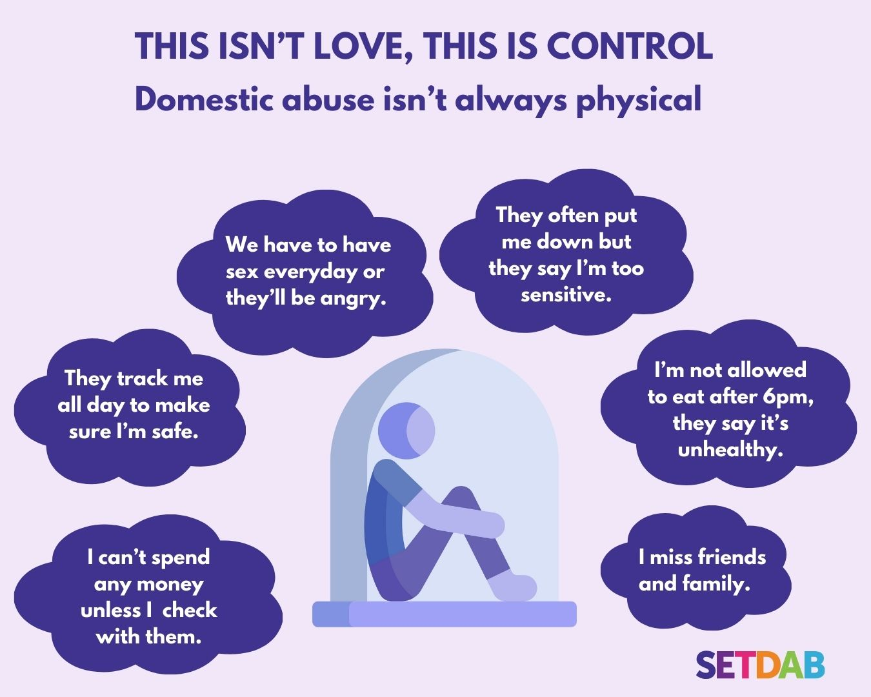
Audience: victim
Coercive control is a form of abuse that uses manipulation, isolation, and fear to dominate someone and can exist behind closed doors, even when everything looks “fine” on the outside.
If you or someone you know needs support, reach out. You are not alone. Call the domestic abuse helpline Essex Compass on 0330 333 7 444 (8.00am to 8.00pm weekdays, 8.00am to 1pm weekends) for help and support or visit essexcompass.org.uk
#DomesticAbuseAwareness #BreakTheSilence #HiddenAbuse #BehindTheSmile

Slide 5


Full set of sized images (Instagram, Facebook, X and LinkedIn) can be found on the SETDAB Website.
Animated content is also available (click on image to play).
We request that no images, graphics, or calls to action within this media pack be altered, edited, or modified in any way. For further information or advice about any of the resources included please contact: domestic.abuseessex@essex.gov.uk

