Slide 1




United Nations 16 Days of Activism Toolkit 2025
If you are a voluntary or statutory organisation in Southend, Essex or Thurrock, that supports SETDAB’s vision, ‘to enable everyone to live a life free from all forms of domestic abuse’, we invite you to share these social media assets and content during the UN 16 Days of Activism campaign. Join us in raising awareness and promoting change. #NoExcuse

Slide 2
The UN 16 Days of Activism campaign taking place from, 25 November to 10 December, is to prevent violence against women and girls, along with changing attitudes in wider society. This year’s campaign theme is “UNiTE to End Digital Violence against all Women and Girls” and is a reminder that digital safety is central to gender equality.
Campaigns running at the same time:
White Ribbon Day - 25 November, this year's campaign #WeSpeakUp, encourages men to use their voices and speak up to create a world where everyone is safe, equal and respected. It focuses on men holding themselves accountable to women and to each other, so we can affect positive behaviour.
For further information or advice about any of the resources included in this toolkit, please contact domestic.abuseessex@essex.gov.uk

Slide 3

Today marks the first day of the unwomenuk.org 16 Days of Activism #NoExcuse. UNiTE to end violence against women and girls.
Over the next 16 days, join us in this global movement to raise awareness, start conversations, and act against gender-based violence.
Every voice matters in creating a safer, more equal world. Whether it’s sharing resources, attending events, or starting a conversation, there’s a role for everyone in this mission.
#16DaysOfActivism #EndGenderBasedViolence #NoExcuse
Shortened
Over the next 16 days, join us in this global movement to raise awareness, start conversations, and UNiTE to end violence against women and girls.
Every voice matters in creating a safer, more equal world.
Right click to save image, add your logo if you wish.

Slide 4
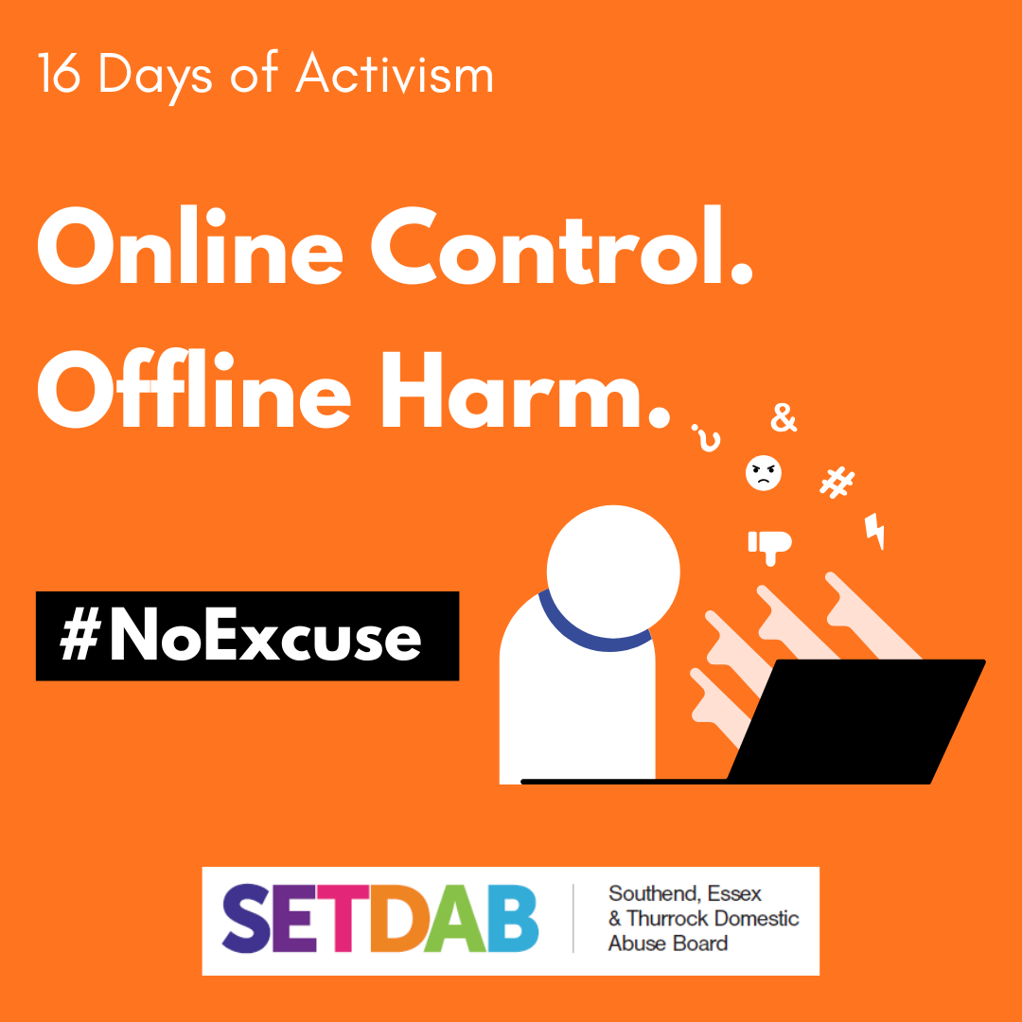
Digital abuse is a form of domestic abuse that uses technology to control, harass, or intimidate.
It can include:
Monitoring your phone or social media
Restricting access to devices or accounts
Sharing or threatening to share private images
Using tracking apps or spyware without consent
Learn more by visiting the link in the comments.
Domestic Digital Stalking - Southend and Thurrock Domestic Abuse Partnership
If you or someone you know is experiencing domestic abuse, help is available. Whether you’re seeking help for yourself or someone else, COMPASS can guide you to the right support. Call 0330 333 7 444 or visit essexcompass.org.uk
Right click to save image

Slide 5

Image-based abuse, sometimes referred to as “revenge porn” is a crime.
It happens when someone shares, threatens to share, or creates sexually explicit images or videos of another person without their consent, often to cause distress, harm, or humiliation.
This includes:
Sharing private images
Threats to distribute content
Digitally altered or fake explicit images (known as deepfakes)
No one should be exploited or controlled through technology. Whether you’re seeking help for yourself or someone else, COMPASS can guide you to the right support. Call 0330 333 7 444 or visit essexcompass.org.uk
Right click to save image

Slide 6

Did you know that your car can be used as tool of control and surveillance in an abusive relationships?
People causing harm may:
Track your location using built-in GPS or apps
Monitor mileage or fuel usage to question your movements
Hide tracking devices in or on the vehicle
Use shared vehicle data to trace your routes
Understand more by reading the SETDAB guide (link in comments)
Vehicles - Southend and Thurrock Domestic Abuse Partnership
Whether you’re seeking help for yourself or someone else, COMPASS can guide you to the right support. Call 0330 333 7 444 or visit essexcompass.org.uk
Right click to save image

Slide 7

Phones, laptops, tablets, and smart home tech can all be misused to monitor, control, or intimidate someone.
People causing harm may:
Access devices remotely
Monitor messages, calls, or browsing history
Use location tracking or hidden apps
Control smart home devices to cause distress
Find out more and how to protect yourself (link in comments).
Smart Devices and Spyware - Southend and Thurrock Domestic Abuse Partnership
Whether you’re seeking help for yourself or someone else, COMPASS can guide you to the right support. Call 0330 333 7 444 or visit essexcompass.org.uk
Right click to save image

Slide 8

Understanding Clare's Law Clare’s Law also know as the Domestic Violence Disclosure Scheme (DVDS), lets you ask the police if your partner or ex-partner has a history of violence or domestic abuse. Named after Clare Wood, who was killed by a partner with a known violent past, this scheme helps protect people by sharing this important information. Anyone, regardless of gender or sexuality, can make an application to Essex Police for themselves or on behalf of someone else, if they have concerns. This includes family, friends or those who may help to keep you safe such as a social worker. Their past doesn’t have to be your future.
Learn more by visiting the link in the comments.
Clare's Law - Southend and Thurrock Domestic Abuse Partnership
Right click to save image

Slide 9

We are supporting #WhiteRibbonDay which encourages people to make consistent choices and actions to change the story for women and girls, so that they may live their lives free from the fear of abuse.
This year’s theme #WeSpeakUp, encourages men to use their voices and speak up to create a world where everyone is safe, equal and respected
It only takes one person to speak up, to call it out, and to help break the cycle of abuse.
Watch this short video: https://www.youtube.com/shorts/58OPmPIAjGQ
Shortened
Today we support #WhiteRibbonDay It only takes one person to speak up, to call it out, and to help break the cycle of abuse. Watch this short video.
#WhiteRibbonDay #WeSpeakUp
Right click to save image, add your logo if you wish

