Slide 1

United Nations 16 Days of Activism Media Pack 2026
If you are a voluntary or statutory organisation in Southend, Essex or Thurrock, that supports SETDAB’s vision, ‘to enable everyone to live a life free from all forms of domestic abuse’, we invite you to share these social media assets and content during the UN 16 Days of Activism campaign.
There is also a Teams background and email signature included, which can be used over the campaign period (25 November – 10 December)
For further information or advice about any of the resources included in this toolkit, please contact domestic.abuseessex@essex.gov.uk

Slide 2
Campaign objective
The UN 16 Days of Activism campaign which takes place from 25 November to 10 December, aims to end violence against women and girls and challenge harmful attitudes in wider society. This year’s campaign theme is - Ensure Justice. Protect Survivors. End Impunity.
You are welcome to adapt the content within this pack to reflect your own branding and style. However, we ask that all content signposts to Compass, the Essex-wide domestic abuse helpline.
Supporting messages
Everyone deserves to feel safe and be heard.
Survivors deserve support without barriers.
Abuse is never justified.
Accountability starts with action.

Slide 3

25 November marks the start of the UN Women 16 Days of Activism.
Women should be safe everywhere, at home, in public and online. Yet one in four women in England and Wales will experience domestic abuse in their lifetime.
Over the next 16 days, join us in raising awareness, challenging harmful attitudes and taking action to end violence against women and girls. Whether you're sharing resources, attending events or starting conversations, everyone can make a difference.
Right-click to save image, add your logo if you wish.

Slide 4

Domestic abuse is not just physical violence. At the heart of abusive relationships is coercive and controlling behaviour - a pattern of actions used to make someone dependent, isolated, threatened or afraid.
It can include:
Dictating what someone wears, eats, where they go, who they see, or how they live their daily life.
Slowly cutting someone off from friends, family or support networks.
Monitoring, checking phones, messages, social media or whereabouts.
Controlling money or preventing financial independence.
Threats, intimidation and emotional abuse – using fear, humiliation or criticism to maintain control.
If you are worried about your own relationship or someone you know, you are not alone, and help is available. Contact Compass the domestic abuse helpline for Southend, Essex and Thurrock. Visit essexcompass.org.uk or call 0330 333 7 444.
Right-click to save image, add your logo if you wish.

Slide 5

Stalking is a criminal offence, and there are a range of legal protections available to help keep victims safe, including Stalking Protection Orders, Non-Molestation Orders and new protections against image-based abuse.
Understanding your rights and the support available is an important step towards staying safe and seeking help.
Read more about stalking legislation, protection orders and victim support here:
Stalking Laws, Protection Orders and Victim Support - Southend and Thurrock Domestic Abuse Partnership
Right-click to save image, add your logo if you wish.

Slide 6
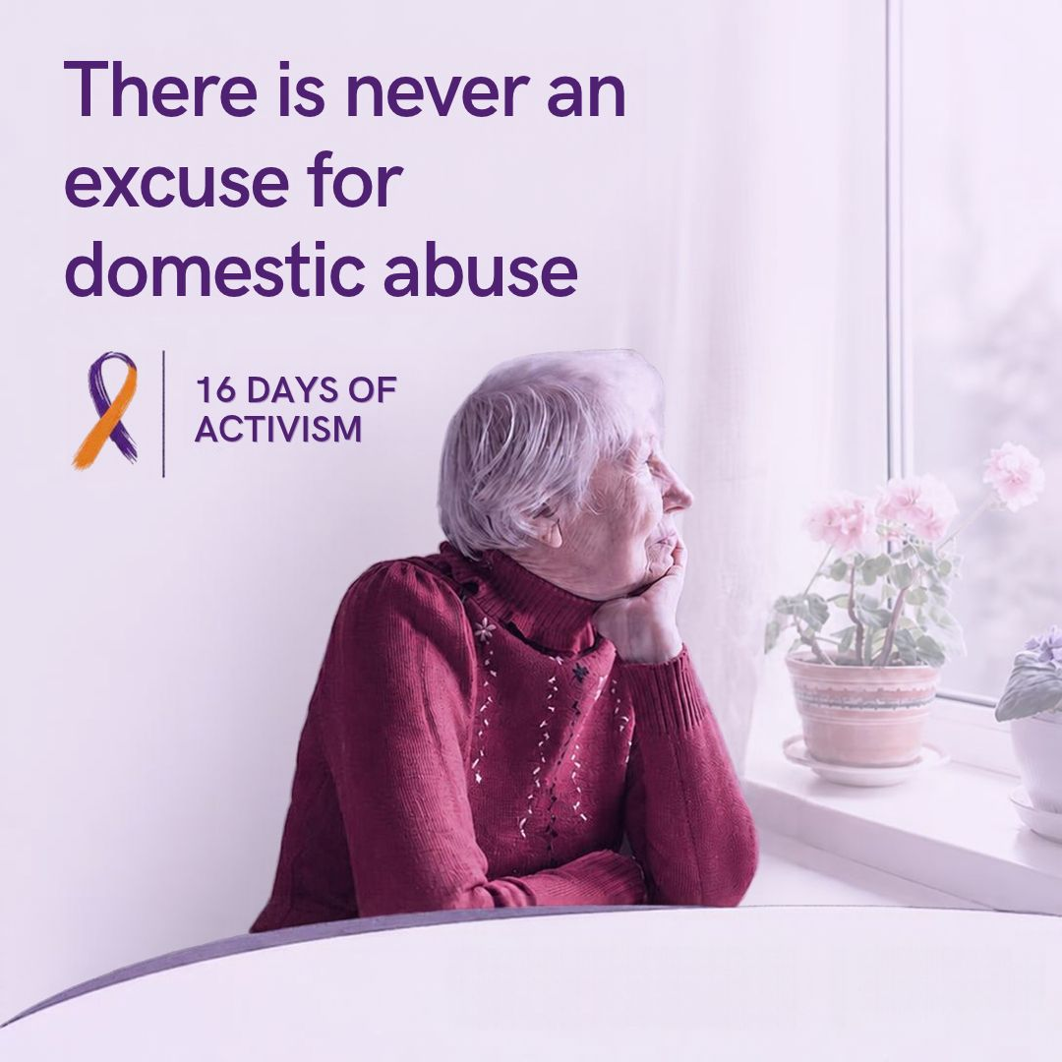
There is never an excuse for domestic abuse.
Abuse is a choice. No matter the circumstances, everyone deserves to feel safe, respected and free from fear.
No matter how long it’s been going on, if you are worried about your own relationship or someone you know support is available.
Whether you’re seeking help for yourself or someone else, Compass can guide you to the right support. Call 0330 333 7 444 or visit essexcompass.org.uk
Right-click to save image, add your logo if you wish.

Slide 7

Image-based abuse, sometimes referred to as “revenge porn”, is a crime.
It happens when someone shares, threatens to share, or creates sexually explicit images or videos of another person without their consent, often to cause distress, harm, or humiliation.
This includes:
Sharing private images
Threats to distribute content
Digitally altered or fake explicit images (known as deepfakes)
No one should be exploited or controlled through technology. Whether you’re seeking help for yourself or someone else, Compass can guide you to the right support. Call 0330 333 7 444 or visit essexcompass.org.uk
Right-click to save image, add your logo if you wish.

Slide 8
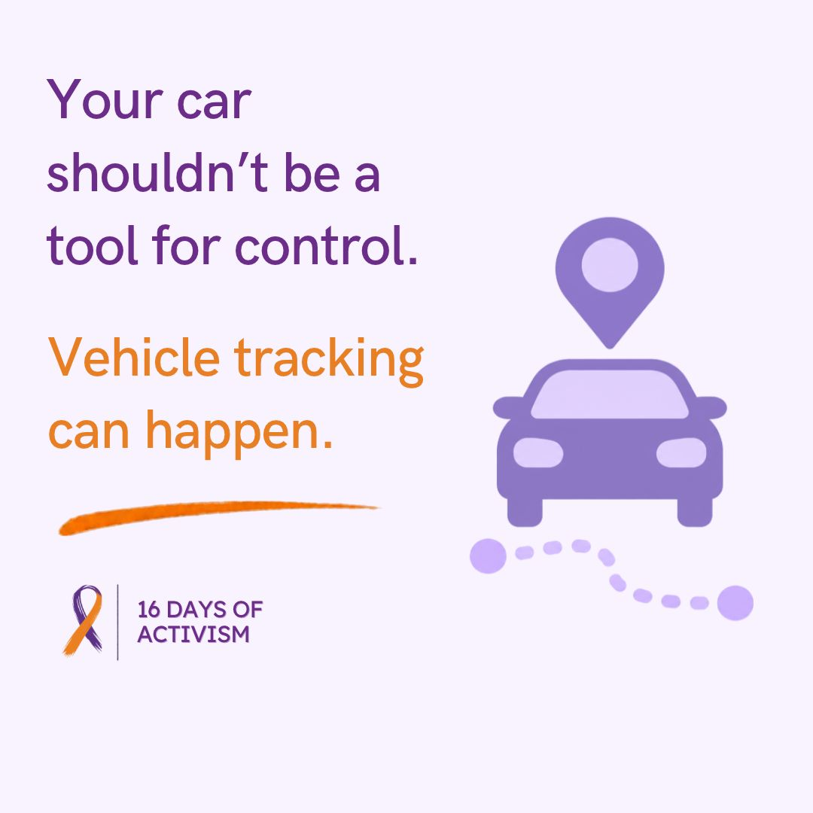
Did you know that your car can be used as a tool for control and surveillance in an abusive relationship?
People causing harm may:
Track your location using built-in GPS or apps
Monitor mileage or fuel usage to question your movements
Hide tracking devices in or on the vehicle
Use shared vehicle data to trace your routes
Understand more by reading the SETDAB guide (link in comments)
Vehicles - Southend and Thurrock Domestic Abuse Partnership
Whether you’re seeking help for yourself or someone else, Compass can guide you to the right support. Call 0330 333 7 444 or visit essexcompass.org.uk
Right-click to save image, add your logo if you wish.

Slide 9
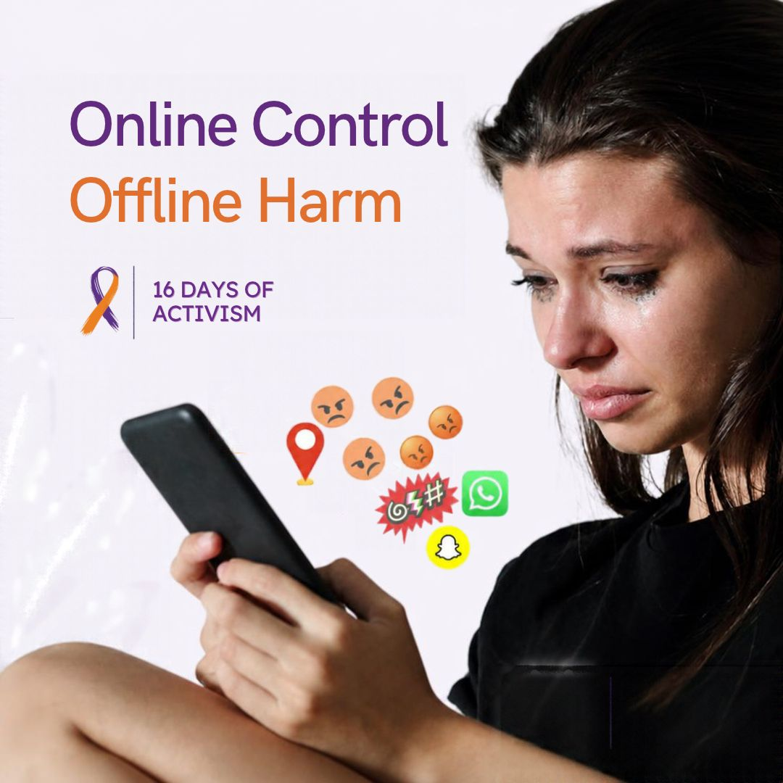
Digital abuse is a form of domestic abuse that uses technology to control, harass, or intimidate.
It can include:
Monitoring your phone or social media
Restricting access to devices or accounts
Sharing or threatening to share private images
Using tracking apps or spyware without consent
Learn more by visiting the link in the comments.
Domestic Digital Stalking - Southend and Thurrock Domestic Abuse Partnership
If you or someone you know is experiencing domestic abuse, help is available. Whether you’re seeking help for yourself or someone else, Compass can guide you to the right support. Call 0330 333 7 444 or visit essexcompass.org.uk
Right-click to save image, add your logo if you wish.

Slide 10
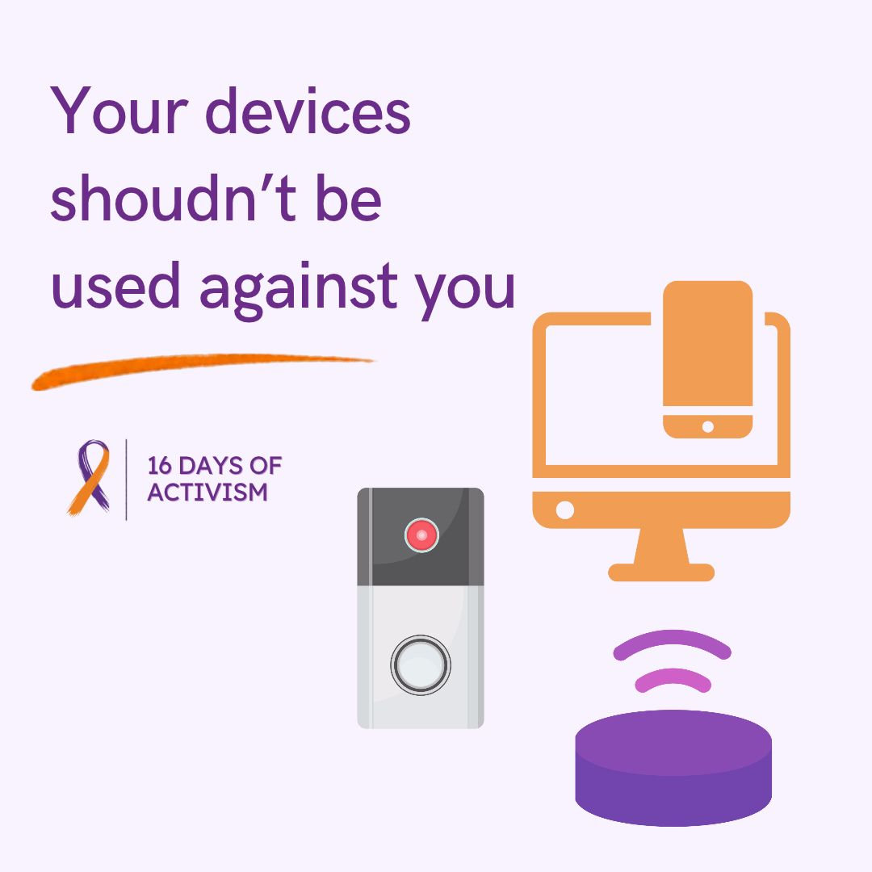
Phones, laptops, tablets, and smart home tech can all be misused to monitor, control, or intimidate someone.
People causing harm may:
Access devices remotely
Monitor messages, calls, or browsing history
Use location tracking or hidden apps
Control smart home devices to cause distress
Find out more and how to protect yourself (link in comments).
Smart Devices and Spyware - Southend and Thurrock Domestic Abuse Partnership
Whether you’re seeking help for yourself or someone else, Compass can guide you to the right support. Call 0330 333 7 444 or visit essexcompass.org.uk
Right-click to save image, add your logo if you wish.

Slide 11

Understanding Clare's Law
Clare’s Law, also known as the Domestic Violence Disclosure Scheme (DVDS), lets you ask the police if your partner or ex-partner has a history of violence or domestic abuse.
Named after Clare Wood, who was killed by a partner with a known violent past, this scheme helps protect people by sharing this important information.
Anyone, regardless of gender or sexuality, can make an application to Essex Police for themselves or on behalf of someone else, if they have concerns. This includes family, friends or those who may help to keep you safe such as a social worker.
Learn more by visiting the link in the comments.
Clare's Law - Southend and Thurrock Domestic Abuse Partnership
Right-click to save image, add your logo if you wish.

Slide 12

"I was stressed." "I was angry." "I'd been drinking." "We were arguing." "I lost control.” There is never an excuse for domestic abuse.
Abuse is a choice. No matter the circumstances, everyone deserves to feel safe, respected and free from fear.
Whether you're concerned about how you respond to conflict, feel controlling or jealous in your relationships, or simply want to better understand what a healthy relationship looks like, there are services that can help.
Contact Compass on 0330 333 7 444 or visit essexcompass.org.uk/reflect-reset/#reflect-reset
Right-click to save image

Slide 13

Email signature
In Outlook go to File then select Options
Select mail and then signatures
Cut or copy the 16 days image and paste to the bottom of your signature
Then select OK
Copy and paste to signature

Slide 14

Teams background
Save the background to your computer
Join a Teams meeting
Turn on camera
Click on effects and avatars
Scroll down to more video effects
Click on add new and upload the background

Slide 15

Campaigns running at the same time:
White Ribbon Day - 25 November, this year's campaign – IT TAKES ALL OF US, encourages men to use their voices and speak up to create a world where everyone is safe, equal and respected. Resources for this campaign can be found here.

