Slide 1


Summer Holiday Communications – Behind The Smiles
Developed by the Southend, Essex and Thurrock Domestic Abuse Partnership and the Essex Safeguarding Adults Board
Tonic report* findings - January 2023
While definitions of domestic abuse has been expanded under the Domestic Abuse Act (2021), it is still often predominantly associated with physical violence and not well understood by the public. Coercive control and psychological abuse are common factors in many cases and are indicators of high harm. However, these aspects of abuse are less well understood.
*The SETDAB TONIC report is a research project commissioned by the Southend, Essex and Thurrock Domestic Abuse Board (SETDAB) and conducted by TONIC. Its purpose was to gain a deeper understanding of the experiences of individuals affected by domestic abuse and to inform improvements in support systems across the region.
Lived in Experience findings – June 2025
Consultation with our lived experience group tells us that people need a range of communications to different audiences to understand what domestic abuse means and the types of abusive behaviours involved.

Slide 2
This content, for use over the summer holiday period, is developed on the theme that domestic abuse can hide behind smiles. It captures how domestic abuse often remains hidden beneath seemingly normal or happy appearance.
The messaging challenges assumptions and helps people recognise that domestic abuse doesn’t always look the way you might expect it to. Abuse isn’t always physical: coercive control, financial, and emotional abuse can be deeply harmful, and you may not immediately see the signs.
It acknowledges that victims may present differently to the outside world whilst experiencing abuse behind closed doors.
Raising awareness that abuse isn’t always physical could help the audience recognise signs they might otherwise miss, it also highlights that seemingly ‘okay’ situations might need closer attention or support. Smiles, social media posts, or public appearances can mask the reality of abuse.
The content directs to Compass, the domestic abuse helpline for across Essex.

Slide 3

Audience: friends and family
Behind some smiles, there’s silence.
Behind some laughter, there’s fear.
Domestic abuse isn’t always physical
Here’s what it can look like:
Gaslighting – Making someone doubt their memory
Monitoring – obsessively checking phones or whereabouts
Verbal abuse – constant criticism or humiliation
Financial control – limiting access to money or work
Threats – using fear to control decisions
Two faces – kind in public, controlling in private
You never know what’s happening behind closed doors.
If you or someone you know needs help, reach out. You are not alone. Call the domestic abuse helpline Essex Compass on 0330 333 7 444 (8.00am to 8.00pm weekdays, 8.00am to 1.00pm weekends) for help and support or visit essexcompass.org.uk
#BehindTheSmile #DomesticAbuseAwareness #BreakTheSilence #HiddenAbuse

Slide 4

Audience: friends and family
Behind some smiles, there’s silence.
Behind some laughter, there’s fear.
Domestic abuse isn’t always physical
Here’s what it can look like:
Gaslighting – Making someone doubt their memory
Monitoring – obsessively checking phones or whereabouts
Verbal abuse – constant criticism or humiliation
Financial control – limiting access to money or work
Threats – using fear to control decisions
Two faces – kind in public, controlling in private
You never know what’s happening behind closed doors.
If you or someone you know needs help, reach out. You are not alone. Call the domestic abuse helpline Essex Compass on 0330 333 7 444 (8.00am to 8.00pm weekdays, 8.00am to 1.00pm weekends) for help and support or visit essexcompass.org.uk
#BehindTheSmile #DomesticAbuseAwareness #BreakTheSilence #HiddenAbuse

Slide 5

Audience: friends and family
Behind some smiles, there’s silence.
Behind some laughter, there’s fear.
Domestic abuse isn’t always physical
Here’s what it can look like:
Gaslighting – making someone question their reality
Monitoring – obsessively checking phones or whereabouts
Verbal abuse – constant criticism or humiliation
Financial control – limiting access to money or work
Threats – using fear to control decisions
Two faces – kind in public, controlling in private
You never know what’s happening behind closed doors.
If you or someone you know needs help, reach out. You are not alone. Call the domestic abuse helpline Essex Compass on 0330 333 7 444 (8.00am to 8.00pm weekdays, 8.00am to 1.00pm weekends) for help and support or visit essexcompass.org.uk
#BehindTheSmile #DomesticAbuseAwareness #BreakTheSilence #HiddenAbuse

Slide 6
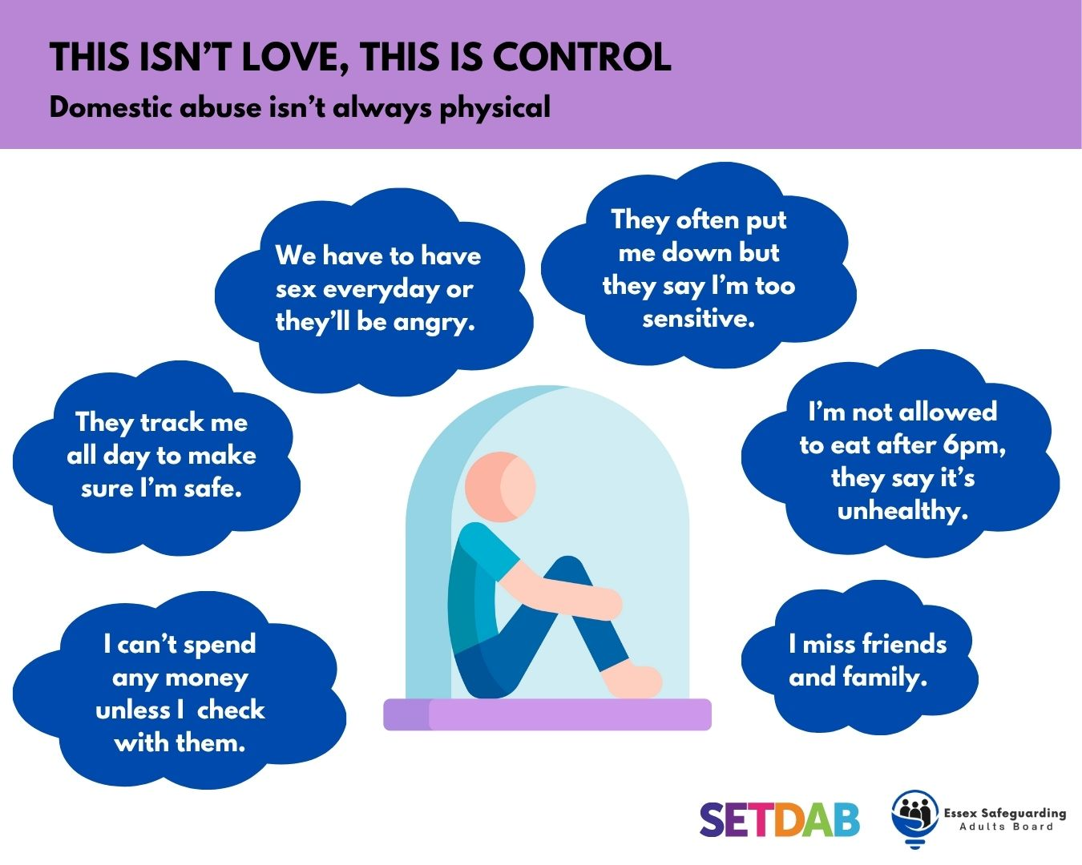
Audience: victim
Coercive control is a form of abuse that uses manipulation, isolation, and fear to dominate someone and can exist behind closed doors, even when everything looks “fine” on the outside.
If you or someone you know needs support, reach out. You are not alone. Call the domestic abuse helpline Essex Compass on 0330 333 7 444 (8.00am to 8.00pm weekdays, 8.00am to 1pm weekends) for help and support or visit essexcompass.org.uk
#DomesticAbuseAwareness #BreakTheSilence #HiddenAbuse #BehindTheSmile

Slide 7

Full set of sized images (Instagram, Facebook, X and LinkedIn) can be found on the SETDAB Website.
Animated content is also available (click on image to play).
We request that no images, graphics, or calls to action within this media pack be altered, edited, or modified in any way. For further information or advice about any of the resources included please contact: domestic.abuseessex@essex.gov.uk

