Slide 1


It’s Never Too Late: Media Pack 2025
The “It’s Never Too Late” campaign aims to raise awareness of the different types of domestic abuse affecting older people, encouraging conversations and helping victims to take the first steps to seeking help from Compass the domestic abuse helpline for Southend, Essex and Thurrock and Southend.
Many older victims of domestic abuse feel it’s too late to reach out for help or fear they won’t be believed.

Slide 2
If you are a voluntary or statutory organisation in Essex, Thurrock or Southend, that can support our shared vision ‘to enable everyone to live a life free from all forms of domestic abuse’, we invite you to share these social media assets and content.
The campaign features adapted content and visuals from the ‘Hidden Harms’ animation, co-created by domestic abuse survivors aged between 60 and 93-years-old from Dewis Choice.
For further information or advice about any of the resources included, please contact domestic.abuseessex@essex.gov.uk
Join us in supporting older people to live safer, happier lives free from domestic abuse.
Developed in consultation with:
SETDAB communications group
Essex Safeguarding Adults Board
Health Watch older people ambassadors
David Cowsill, Area Coordinator and Well-being Lead, Dewis Choice

Slide 3
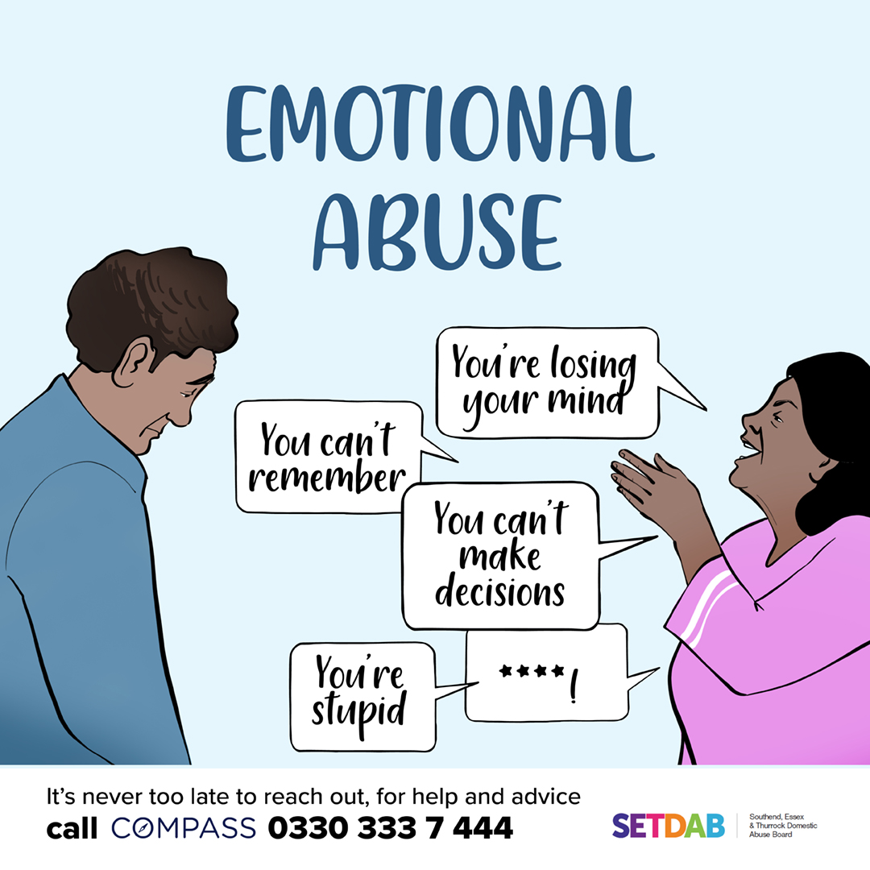
Are you feeling unhappy about the way a family member or partner is treating you? Are they criticising you and making you feel bad about yourself?
Maybe the behaviour just started or recently got worse, even if it’s always been like this it doesn’t mean it’s ok.
Essex Compass can offer help and advice. Call 0330 333 7 444 or visit their website for assistance. You are not alone. #ItsNeverTooLate
Essex Compass
Shortened
Feeling unhappy about how a family member or partner treats you? Are they criticising you and making you feel bad about yourself? Essex Compass can help. Call 0330 333 7 444 or visit their website. #ItsNeverTooLate
Right click to save photo

Slide 4

Have you lost control of your money and access to finances?
Is a partner or family member taking your money without permission or making you feel like you can’t say no?
No matter how long it’s been going on, it’s never too late to reach out for help.
Essex Compass can offer help and advice. Call 0330 333 7 444 or visit their website for assistance. You are not alone.
Essex Compass
#ItsNeverTooLate
Shortened
Have you lost control of your finances, is a partner or family member taking your money without permission or making you feel like you can’t say no? Essex Compass can help. Call 0330 333 7 444 or visit their website. #ItsNeverTooLate
Right click to save photo

Slide 5
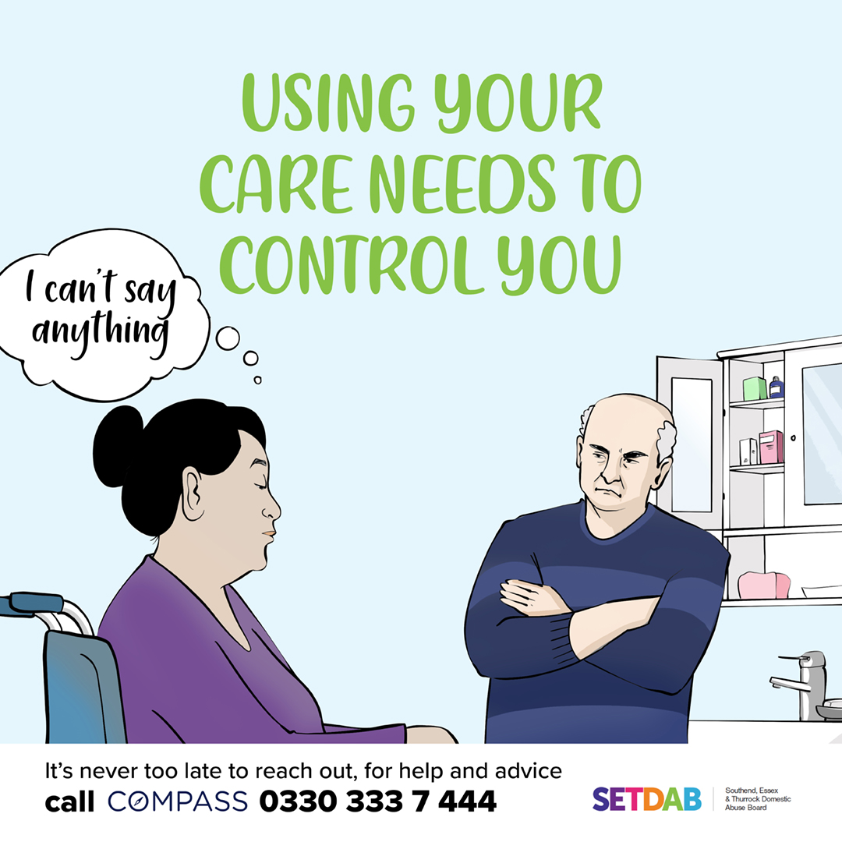
Do you feel a family member or partner is exaggerating your care needs or using them as an excuse to control what you do, eat or where you go?
Maybe the behaviour just started or recently got worse, even if it’s always been like this it doesn’t mean it’s ok.
Essex Compass can offer help and advice. Call 0330 333 7 444 or visit their website for assistance. You are not alone.
Essex Compass
#ItsNeverTooLate
Shortened
Is a family member or partner using your care needs to control you? It's not okay, no matter how long it's been going on Essex Compass can help. Call 0330 333 7 444 or visit their website. #ItsNeverTooLate
Right click to save photo

Slide 6
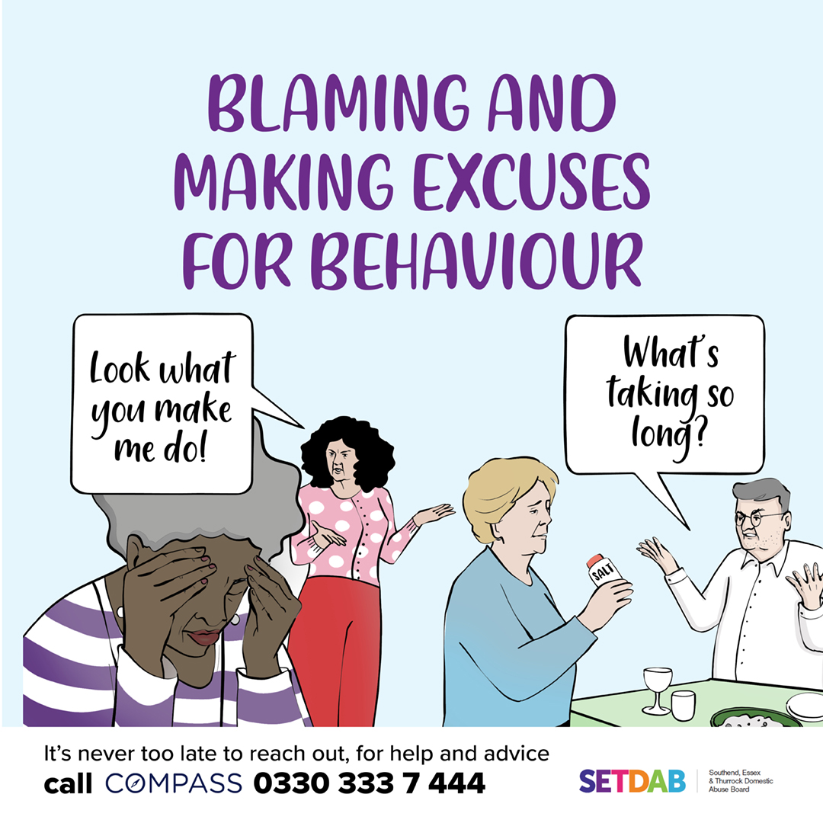
Is a family member or partner making excuses for treating you badly or blaming you for their behaviour?
Maybe the behaviour just started or recently got worse, even if it’s always been like this it doesn’t mean it’s ok.
No matter how long it’s being going on it's never too late to reach out for help.
Essex Compass can offer help and advice. Call 0330 333 7 444 or visit their website for assistance. You are not alone. #ItsNeverTooLate
Essex Compass
Shortened
Is a family member or partner blaming or making excuses you for treating you badly? It's not okay, no matter how long it's been going on Essex Compass can help. Call 0330 333 7 444 or visit their website. #ItsNeverTooLate
Right click to save photo

Slide 7
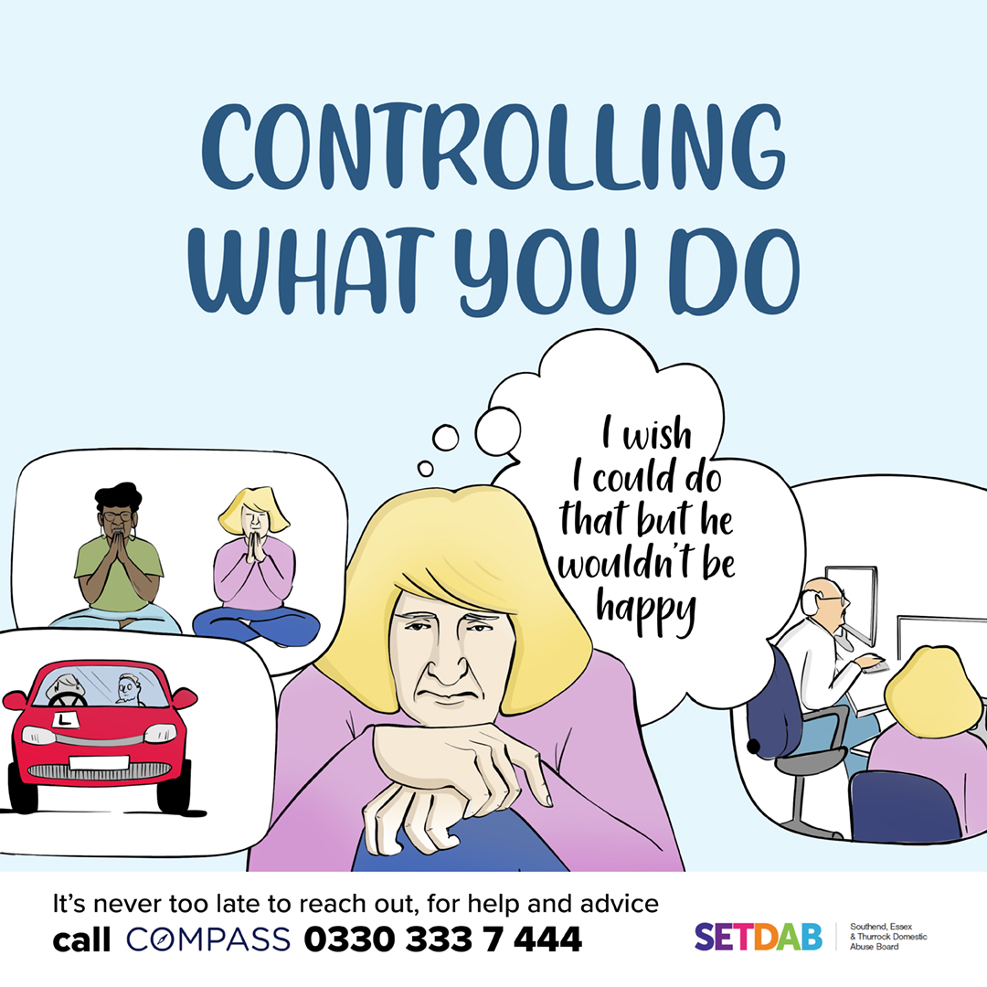
Is a partner or family member stopping you from trying new things, learning new skills, or doing the things you enjoy?
No matter how long it’s being going on, if this is making you feel unhappy it's never too late to reach out for help.
Essex Compass can offer help and advice. Call 0330 333 7 444 or visit their website for assistance. You are not alone. #ItsNeverTooLate
Essex Compass
Shortened
Is a partner or family member stopping you from trying new things or doing what you enjoy? It's not okay, no matter how long it's been going on Essex Compass can help. Call 0330 333 7 444 or visit their website. #ItsNeverTooLate
Right click to save photo

Slide 8
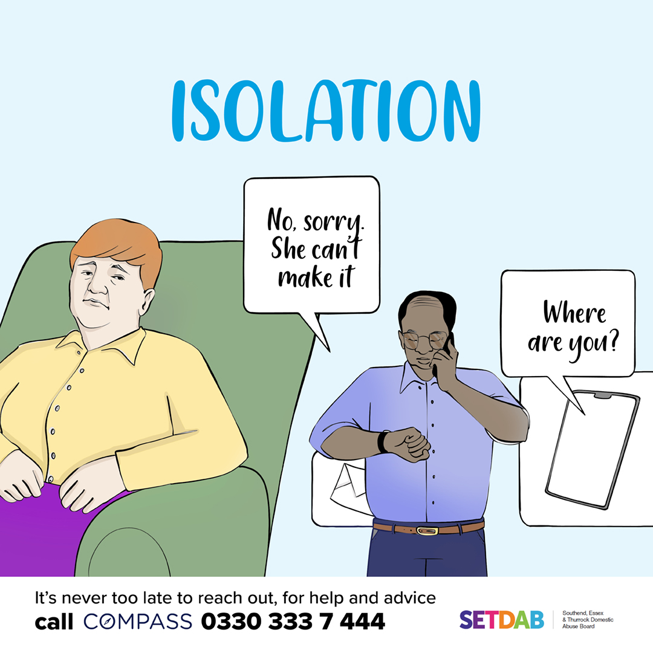
Is a partner or family member stopping you from seeing other people or spoiling the time you do have with family and friends?
They may be checking your messages or constantly checking where you are.
Maybe the behaviour just started or recently got worse, even if it’s always been like this it doesn’t mean it’s ok. It's never too late to reach out for help.
Essex Compass can offer help and advice. Call 0330 333 7 444 or visit their website for assistance. You are not alone. #ItsNeverTooLate
Essex Compass
Shortened
Is a partner or family member isolating you, checking your messages, or controlling your time with others? It's not okay, no matter how long it's been going on Essex Compass can help. Call 0330 333 7 444 or visit their website. #ItsNeverTooLate
Right click to save photo

Slide 9
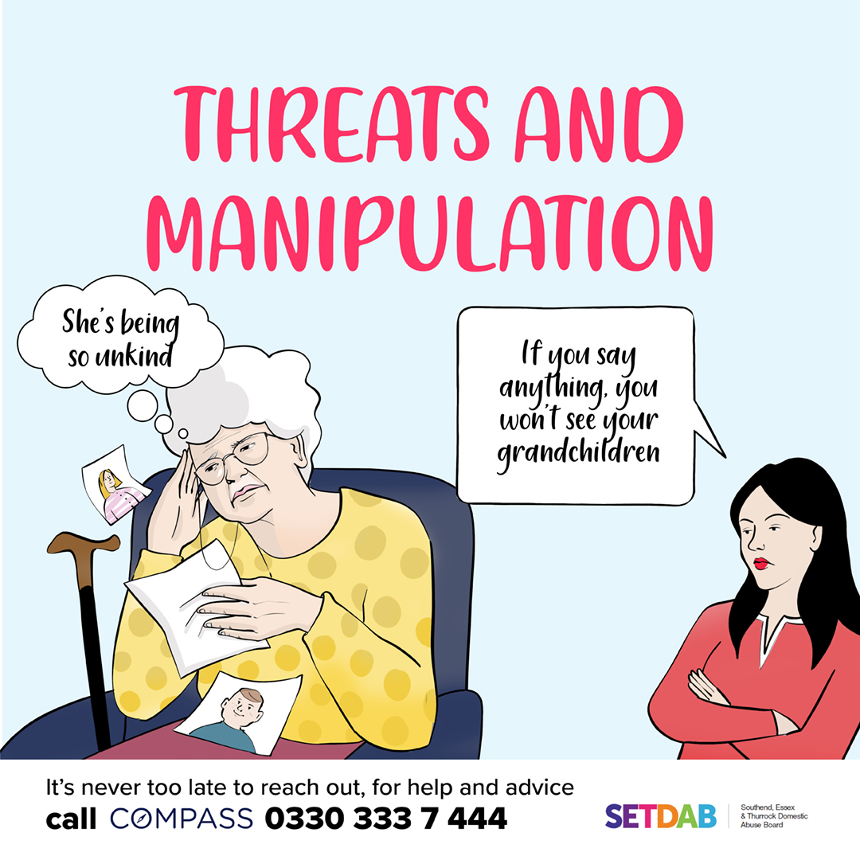
Are you feeling unhappy about the way a family member or partner is treating you?
Are they threatening bad things will happen if you don’t do as they say?
It’s never too late to reach out for help or talk to someone about what you are experiencing.
Essex Compass can offer help and advice. Call 0330 333 7 444 or visit their website for assistance. You are not alone. #ItsNeverTooLate
Essex Compass
Shortened
Is a partner or family member threatening bad things will happen if you don’t do as they say? No matter how long it's been going on it’s never too late to reach out for help. Essex Compass can help. Call 0330 333 7 444 or visit their website. #ItsNeverTooLate
Right click to save photo

Slide 10
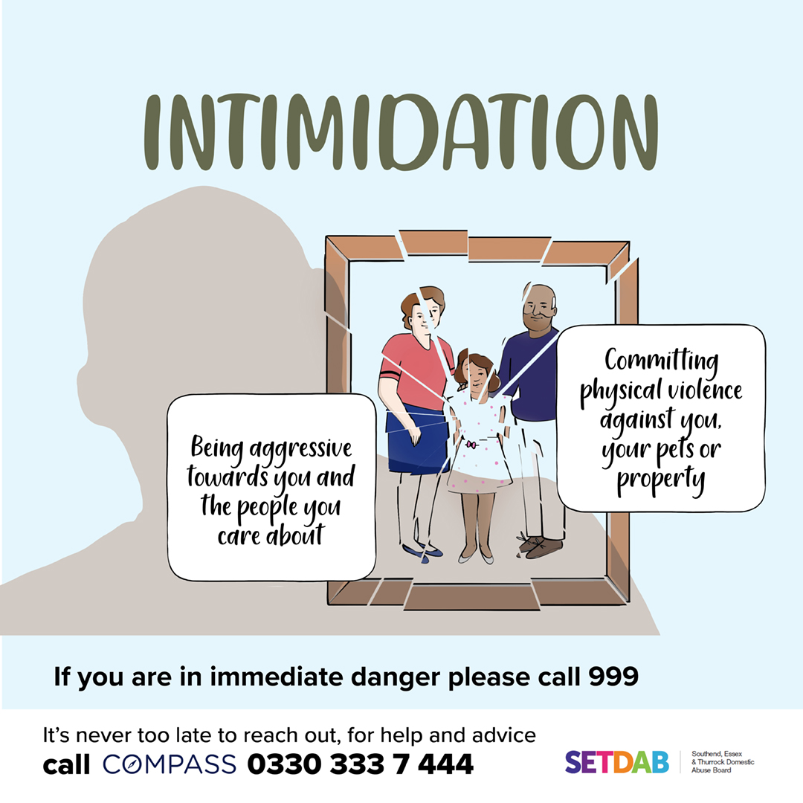
Is a family member or partner being angry, aggressive and violent towards you or the people you care about?
Maybe the behaviour just started or recently got worse, even if it’s always been like this it doesn’t mean it’s ok.
No matter how long it’s being going on, it's never too late to reach out for help.
Essex Compass can offer help and advice. Call 0330 333 7 444 or visit their website for assistance. You are not alone.
#ItsNeverTooLate
Essex Compass
Shortened
Is a family member or partner being angry, aggressive, or violent towards you or the people you care about? It's not okay, no matter how long it's been going on Essex Compass can help. Call 0330 333 7 444 or visit their website. #ItsNeverTooLate
Right click to save photo

Slide 11

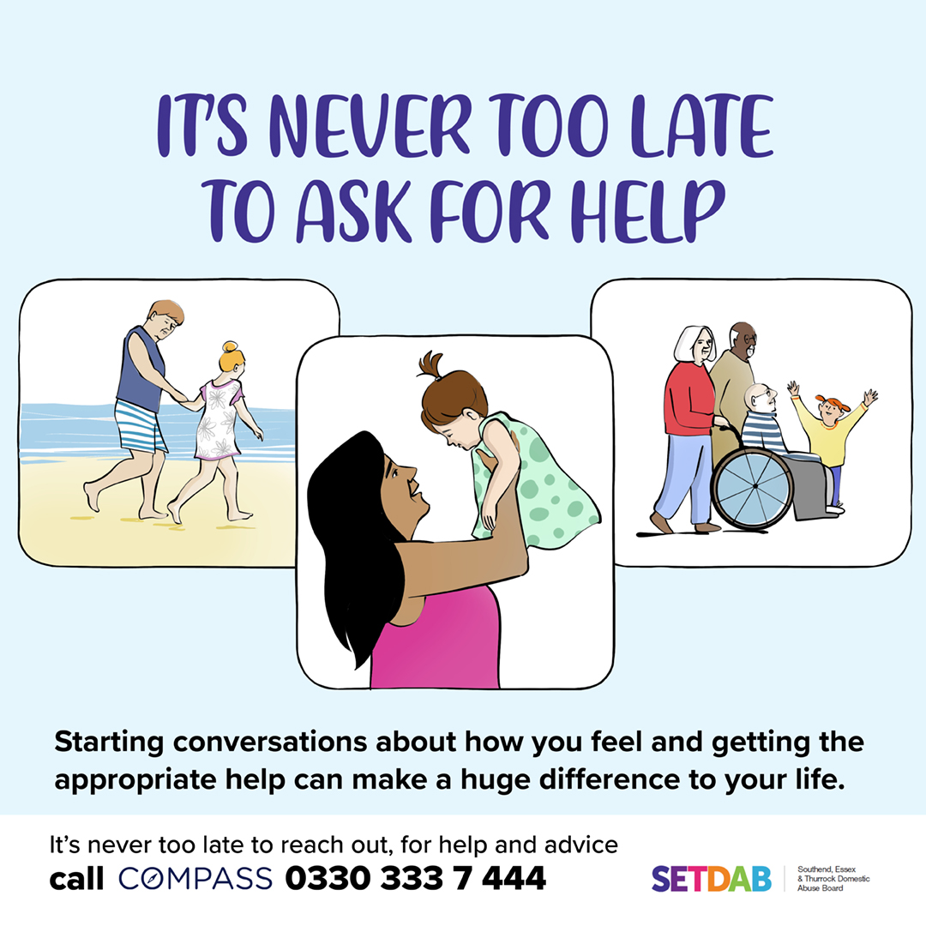
These two assets can be used as an addition to any of the others.
Right click to save photo

