Slide 1
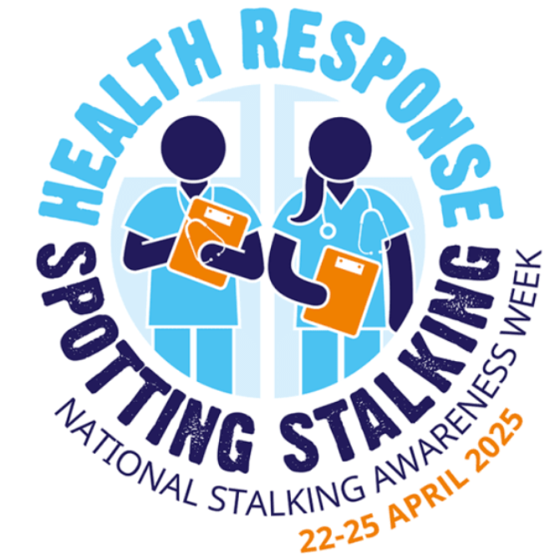
Campaign Theme: Health Response: Spotting Stalking
Emphasises the important role healthcare providers play in identifying and supporting victims of stalking.
SETDAB campaign toolkit
Stalking Awareness Week
22 to 25 April 2025
Link: National Stalking Awareness Week Conference 2025: Health Response: Spotting Stalking | Suzy Lamplugh Trust

Slide 2
Facebook
We are working in partnership to support the Suzy Lamplugh Trust’s National Stalking Awareness Week, 22 to 25 April.
Stalking is a pattern of fixated, obsessive, unwanted, repeated abusive behaviours and a series of actions that occur over time which are intrusive and make you feel scared and distressed. It is a criminal offence and anyone can be a victim.
It can include anything from non-stop calls and text messages, unwanted gifts, watching or turning up at your home or workplace, following you, damaging your property and using family members to get to you.
If you see the signs Compass can help. Call 0330 333 7 444 or visit their website for assistance.
About Compass
#StalkingAwareness #stalking #NSAW2025 #thebiggerpicture
Instagram
We are working in partnership to support the Suzy Lamplugh Trust’s National Stalking Awareness Week, 22 to 25 April. #Stalking is a pattern of persistent and unwanted attention that makes you feel scared, anxious or harassed. If you see the signs reach out to @essexcompass who can help you. Call 0330 333 7 444 or visit their website by searching for Essex Compass.
#StalkingAwareness #NSAW2025 #thebiggerpicture
Right click your mouse to save picture and use

Slide 3
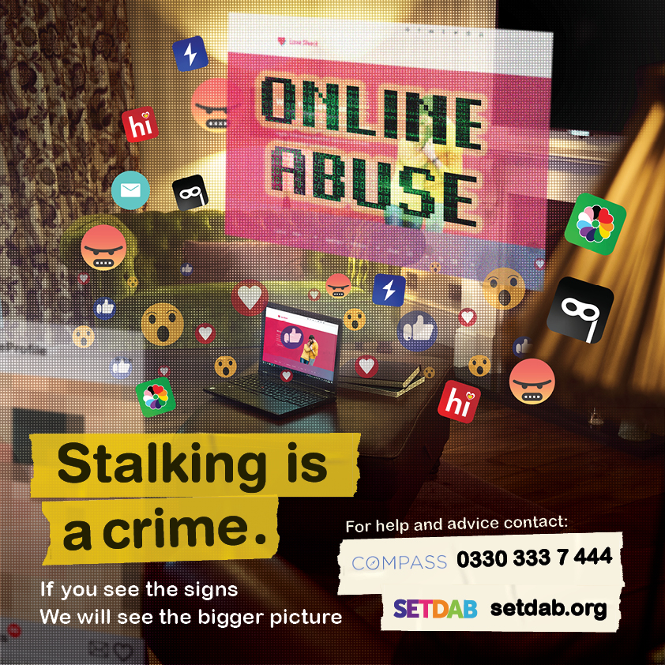
Facebook
Cyberstalking is when a person keeps track of you online or uses other electronic means to harass, scare, or threaten physical harm.
What can you do?
Be mindful of what you share online
Regularly check and update your privacy settings on social media platforms
Regularly change passwords
Turn off location tagging on posts
Keep a record, screen shot or log of calls and text messages
If you are being stalked help is available from Compass, call 0330 333 7 444 or visit their website. Compass
#NSAW2025 #thebiggerpicture #StalkingAwareness #stalking
Instagram
Cyberstalking includes tracking you online to harass or threaten. Be mindful what you share online, update your privacy settings on social media, change passwords. Keep records of unwanted calls/messages.
If you are being stalked help is available from @essexcompass call 0330 333 7 444 or visit their website by searching for Essex Compass.
#NSAW2025 #thebiggerpicture #StalkingAwareness #stalking
Right click your mouse to save picture and use

Slide 4
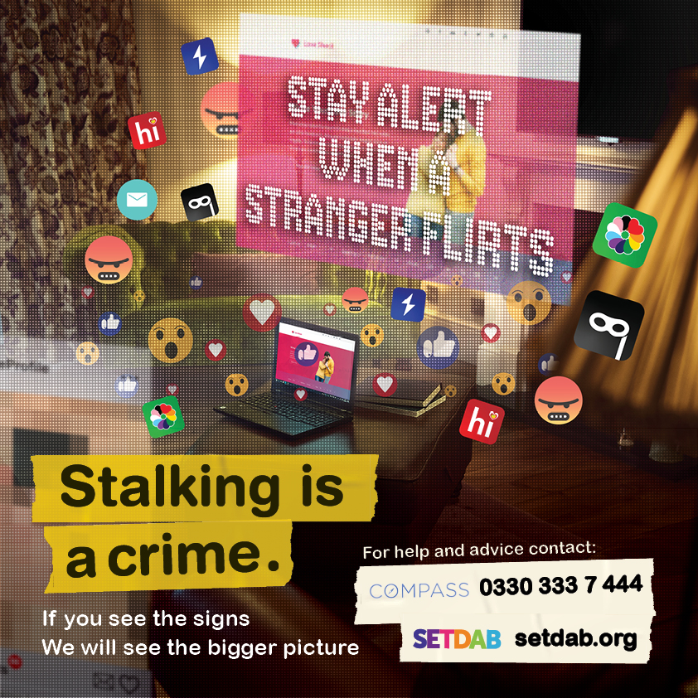
Facebook
Being afraid to check your phone, always looking over your shoulder, feeling isolated and trapped in your own home - these are some of the terrifying experiences often faced by victims of stalking.
Read Hayley's story to understand how stalking affected her life.
A Stalking Case Study - Hayley’s online stalking nightmare - Southend and Thurrock Domestic Abuse Partnership (setdab.org)
Stalking is a crime, and if something doesn’t feel right, help is available from Compass. Call 0330 333 7 444 or visit their website. Compass
#NSAW2025 #thebiggerpicture #StalkingAwareness
Instagram
Afraid to check your phone or leave your home, always looking over your shoulder - these are some of the terrifying experiences faced by stalking victims.
Stalking is a crime, and if something doesn’t feel right, help is available from @essexcompass Call 0330 333 7 444 or visit their website by searching for Essex Compass.
#NSAW2025 #thebiggerpicture #StalkingAwareness #stalking
Right click your mouse to save picture and use

Slide 5
Facebook
Cyberstalking can take various forms, including unauthorised access or manipulation of smart home devices, such as Alexa, heating systems or smart locks. Find out more how to protect yourself by visiting
Get Safe Online | The UK's leading Online Safety Advice Resource
Stalking is a crime, if you see the signs reach out to Compass who will help you. Call 0330 333 7 444 or visit their website for assistance. Remember you are not alone. Compass
#NSAW2025 #thebiggerpicture #StalkingAwareness
Instagram
Be aware of cyberstalking which can take various forms, including unauthorised access or manipulation of smart home devices, such as Alexa, heating systems or smart locks.
Stalking is a crime, if you see the signs reach out to @essexcompass who will help you. Call 0330 333 7 444 or visit their website by searching for Essex Compass.
#NSAW2025 #thebiggerpicture #StalkingAwareness
Right click your mouse to save picture and use

Slide 6
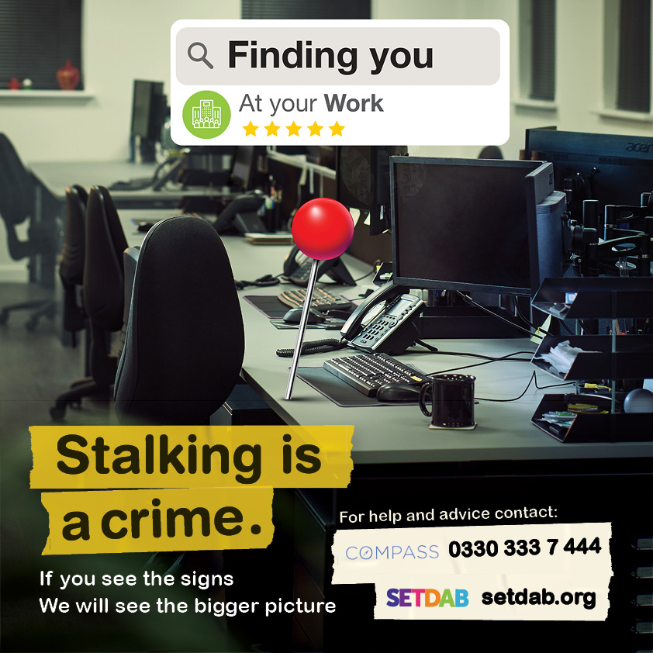
Facebook
Is your ex-partner following you, turning up at your work, or constantly contacting you? Are you changing your usual pattern or route to work to avoid them?
Read Rosie's story to understand how stalking affected her life
If you think you’re being stalked, there is help available through Essex Compass, call 0330 333 7 444 or visit their website. Compass.
Trust your instincts and get the help you need today.
#StalkingAwareness #stalking #NSAW2025 #thebiggerpicture
Instagram
Is your ex-partner stalking you, showing up at work, or bombarding you with messages? Are you altering your routine to avoid them? If you think you’re being stalked, reach out to @essexcompass who can help you. Call 0330 333 7 444 or visit their website by searching for Essex Compass.
Trust your instincts and get the help you need today.
#StalkingAwareness #stalking #NSAW2025 #thebiggerpicture
Right click your mouse to save picture and use

Slide 7
Facebook
Are you being bombarded with unwanted texts, emails or messages? Is the constant unwanted contact making you feel uncomfortable or frightening you? Stalking poses a real threat of harm. Trust your instincts and please reach out for help through Compass, call 0330 333 7 444 or visit their website. Compass
#NSAW2025 #thebiggerpicture #StalkingAwareness #stalking
Instagram
Are you overwhelmed by unwanted texts, emails, or messages? Feeling frightened by constant contact? You're not alone. #Stalking poses a real threat of harm. Trust your instincts and get help by contacting @essexcompass
call 0330 333 7 444 or visit their website by searching for Essex Compass.
#NSAW2025 #thebiggerpicture #StalkingAwareness #stalking
Right click your mouse to save picture and use

Slide 8
Facebook
Is your controlling ex-partner turning up at the same places as you such as the local bar, the supermarket, your gym or GP? Could your partner be tracking you via your phone or an apple tag.
If you think you’re being stalked, there is help available through Essex Compass, call 0330 333 7 444 or visit their website. Compass
Trust your instincts and get the help you need today.
#NSAW2025 #thebiggerpicture #StalkingAwareness #stalking
Instagram
Feeling like your ex-partner is everywhere you go? Whether it's the bar, supermarket, gym, or even your GP, 📱 Could they be tracking you? Trust your instincts and seek help by reaching out to @essexcompass Call 0330 333 7 444 or visit their website by searching for Essex Compass.
#NSAW2025 #thebiggerpicture #StalkingAwareness #stalking
Right click your mouse to save picture and use

Slide 9
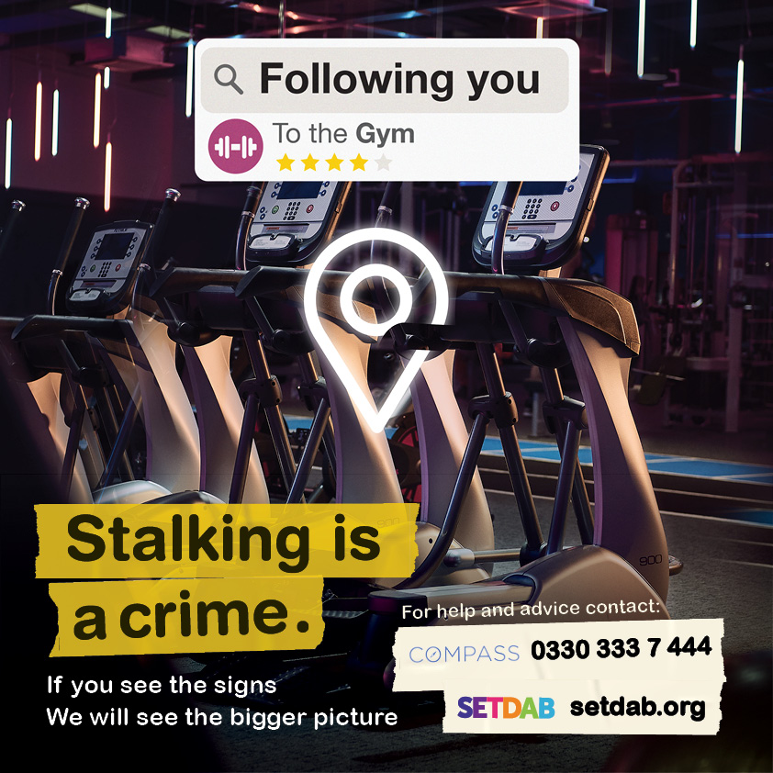
Facebook
Is your controlling ex-partner turning up at the same places as you such as the local bar, the supermarket, your gym or GP? Could your partner be tracking you via your phone or an apple tag.
If you think you’re being stalked, there is help available through Compass, call 0330 333 7 444 or visit their website. Compass
Trust your instincts and get the help you need today.
#StalkingAwareness #stalking #NSAW2025 #thebiggerpicture
Instagram
Feeling like your ex-partner is everywhere you go? Whether it's the bar, supermarket, gym, or even your GP, 📱 Could they be tracking you? Trust your instincts and seek help. Reach out to @essexcompass who can help you. Call 0330 333 7 444 or visit their website by searching for Essex Compass.
#StalkingAwareness #stalking #NSAW2025 #thebiggerpicture
Right click your mouse to save picture and use

Slide 10
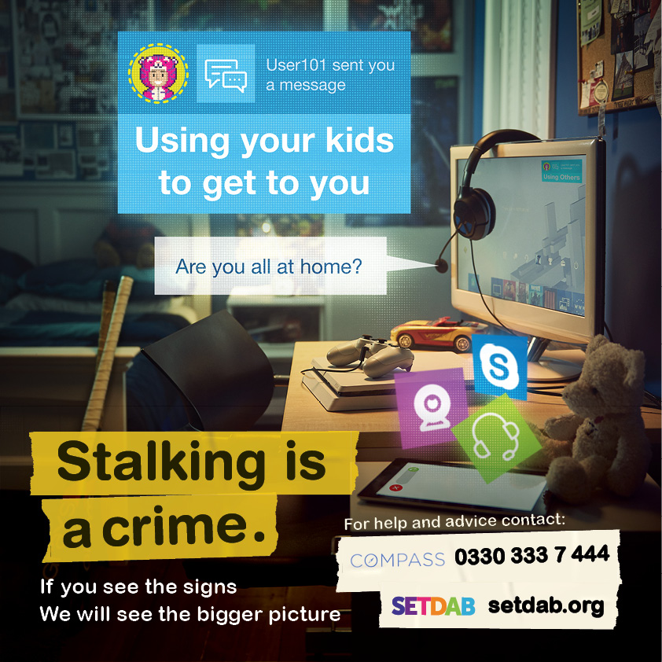
Facebook
Is your ex-partner using your kids or family members to get to you, threaten you or find out information about you? Maybe they are turning up at the school gates and using the school in some way to get to you. Is their obsessive behaviour causing you distress? Stalking can have a huge impact on you and your family.
If you think you’re being stalked, there is help available through Compass, call 0330 333 7 444 or visit their website.
Trust your instincts and get the help you need today.
#StalkingAwareness #stalking #NSAW2025 #thebiggerpicture
Instagram
Is your ex-partner involving your kids or family to intimidate you or gather information? #Stalking doesn't just affect the victim—it impacts families too. Don't suffer in silence. Reach out to @essexcompass who can help you. Call 0330 333 7 444 or visit their website by searching for Essex Compass.
#StalkingAwareness #stalking #NSAW2024 #thebiggerpicture
Right click your mouse to save picture and use

Slide 11
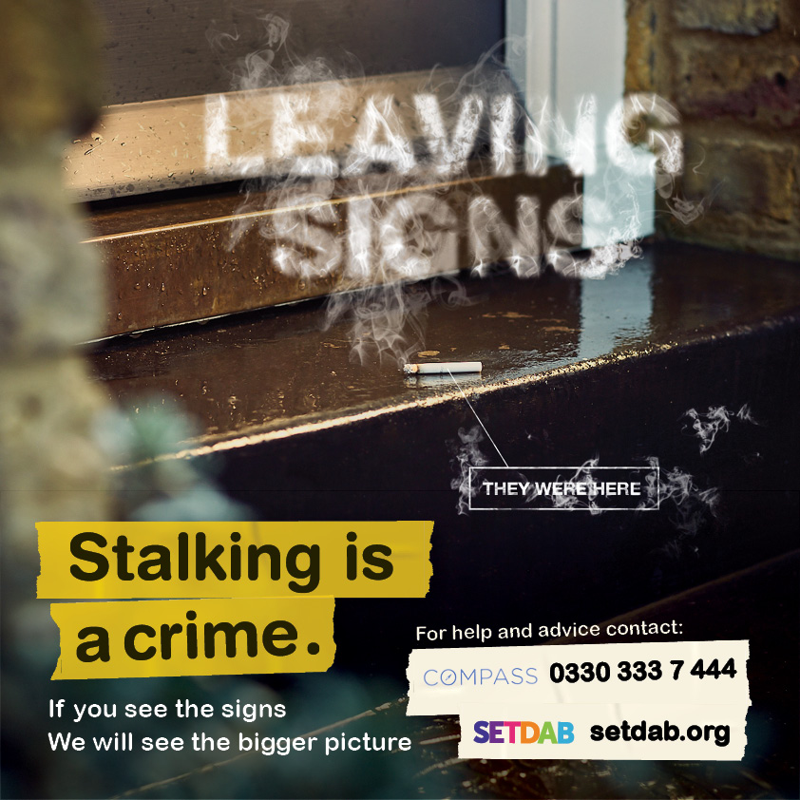
Facebook
Did you know that stalkers often leave subtle signs to let you know that they have ‘been there’, with the aim of psychologically tormenting you. The mind games and emotional abuse can lead to anxiety or depression. Don't suffer in silence.
If you suspect you are being stalked, reach out for support. Compass is here to help. Call 0330 333 7 444 or visit their website for assistance. Compass.
#StalkingAwareness #stalking #NSAW2025 #thebiggerpicture
Instagram
Did you know that #stalkers often leave subtle signs to let you know that they have ‘been there’, with the aim of psychologically tormenting you. If you see the signs reach out to @essexcompass who can help you. Call 0330 333 7 444 or visit their website by searching for Essex Compass.
#StalkingAwareness #stalking #NSAW2025 #thebiggerpicture
Right click your mouse to save picture and use

Slide 12
Facebook
Is the damage to your property an isolated incident or is it part of a bigger picture? Unlike other crimes, which usually involve one act, stalking is a series of actions that occur over a period of time.
If you suspect you're being stalked, reach out for support. Compass is here to help. Call 0330 333 7 444 or visit their website for assistance. You're not alone. Compass.
#StalkingAwareness #stalking #NSAW2025 #thebiggerpicture
Instagram
Is the damage to your property an isolated incident or is it part of a bigger picture? Unlike other crimes, which usually involve one act, #stalking is an unwanted series of actions that occur over a period of time. Don't suffer in silence. If you see the signs reach out to @essexcompass who can help you. Call 0330 333 7 444 or visit their website by searching for Essex Compass.
#StalkingAwareness #NSAW2024 #thebiggerpicture
Right click your mouse to save picture and use

Slide 13
Facebook
Are you being sent unwanted gifts? Are you receiving unwanted deliveries or abusive letters through the post? Are you feeling uneasy about the unwanted attention or feeling threatened and frightened?
Stalking is a pattern of persistent and unwanted attention that makes you feel scared, anxious or harassed.
For help or advice contact Compass by calling 0330 333 7 444 or visit their website for assistance. Compass.
#StalkingAwareness #stalking #NSAW2025 #thebiggerpicture
Instagram
Are you being sent unwanted gifts? Are you receiving unwanted deliveries or abusive letters through the post? #Stalking is a pattern of persistent and unwanted attention that makes you feel scared, anxious or harassed. If you see the signs reach out to @essexcompass who can help you. Call 0330 333 7 444 or visit their website by searching for Essex Compass.
#StalkingAwareness #NSAW2025 #thebiggerpicture #domesticabuse #signsofstalking
Right click your mouse to save picture and use

Slide 14
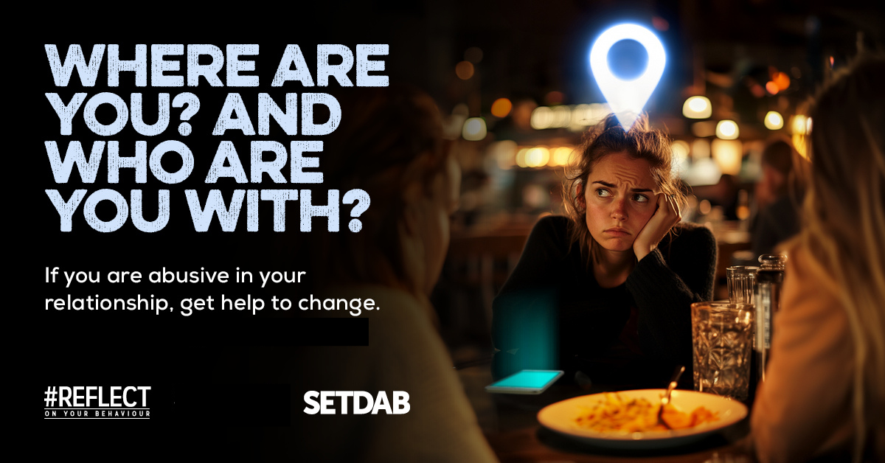
Perpetrator Focused
Facebook
Spending all your time tracking your partner or ex-partner’s movements? Maybe you turned up at their house when they didn’t want you there or sent hundreds of messages when they didn’t pick up the phone. Are feelings of jealousy taking over your life?
If you recognise any of these behaviours it’s time to #REFLECT, there is help available to change. Call Compass today on 0330 333 7 444 or visit their website.
Behaviour Change Support - Essex Compass
#REFLECT #HealthyRelationships #StalkingAwareness #NSAW2025
Right click your mouse to save picture and use

Slide 15
Perpetrator Focused
Facebook
Spending all your time tracking your partner or ex-partner’s movements? Maybe you turned up at their house when they didn’t want you there or sent hundreds of messages when they didn’t pick up the phone. Are feelings of jealousy taking over your life?
If you recognise any of these behaviours it’s time to #REFLECT, there is help available to change. Call Compass today on 0330 333 7 444 or visit their website.
Behaviour Change Support - Essex Compass
Instagram
Spending all your time tracking your partner or ex-partner’s movements, showing up uninvited, using other people to get to your partner, sending excessive messages? Jealousy taking over? It’s time to #REFLECT- there's help available to change. 🌟 Call Compass at 0330 333 7 444 or visit their website by searching for Essex Compass.
#REFLECT #HealthyRelationships #StalkingAwareness #NSAW2025
Right click your mouse to save picture and use

Slide 16
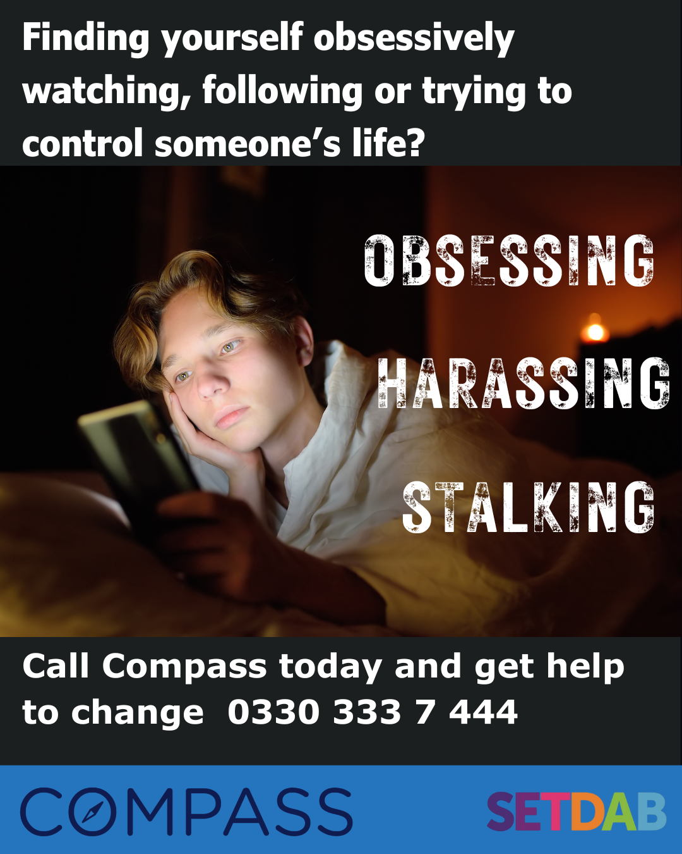
Perpetrator Focused
Facebook
Are you spending all your time tracking your partner or ex-partner’s movements – maybe you turned up at their house when they didn’t want you there or sent hundreds of messages when they didn’t pick up the phone. Are you feeling rejected and like you’re losing control?
If you recognise any of these behaviours, there is help available to change. Call Compass today on 0330 333 7 444 or visit their website.
Behaviour Change Support - Essex Compass
Instagram
Feeling rejected and losing control? Are you spending all your time tracking your partner or ex-partner’s movements, showing up uninvited, sending excessive messages or unwanted gifts? There's help available to change. 🌟 Call Compass at 0330 333 7 444 or visit their website by searching for Essex Compass.
#HealthyRelationships #StalkingAwareness #NSAW2025
Right click your mouse to save picture and use

Slide 17
Perpetrator Focused
Facebook
Are you spending all your time tracking your partner or ex-partner’s movements? Maybe you turned up at their house when they didn’t want you there or sent hundreds of messages when they didn’t pick up the phone.
If you recognise any of these behaviours, there is help available to change. Call Compass today on 0330 333 7 444 or visit their website.
Behaviour Change Support - Essex Compass
Instagram
Spending all your time tracking your partner or ex-partner’s movements, showing up uninvited, sending excessive messages or unwanted gifts? There's help available to change. 🌟 Call Compass at 0330 333 7 444 or visit their website by searching for Essex Compass
#HealthyRelationships #StalkingAwareness #NSAW2025
Right click your mouse to save picture and use

Slide 18
Perpetrator Focused
Facebook
Are you spending all your time tracking your partner or ex-partner’s movements. Maybe you turned up at their house when they didn’t want you there, or using the kids or friends to get to your partner.
Do you feel rejected and like you’re are losing control, are feelings of jealousy taking over your life?
If you recognise any of these behaviours, there is help available to change. Call Compass today on 0330 333 7 444 or visit their website.
Behaviour Change Support - Essex Compass
Instagram
Spending all your time tracking your partner or ex-partner’s movements, showing up uninvited, using other people to get to your partner, sending excessive messages or gifts? Jealousy taking over? There's help available to change. 🌟 Call Compass at 0330 333 7 444 or visit their website by searching for Essex Compass.
#HealthyRelationships #StalkingAwareness #NSAW2025
Right click your mouse to save picture and use

