Slide 1
Join forces against stalking Media Pack
SETDAB Stalking Awareness Week
22-26 April 2024
Campaign Theme: "Join Forces Against Stalking"
Joining forces, and working together to effectively support victims of stalking
Link: National Stalking Awareness Week Conference 2024: "Join Forces Against Stalking" | Suzy Lamplugh Trust

Slide 2
Facebook
Southend, Essex and Thurrock Domestic Abuse Board (SETDAB) are working in partnership to support the Suzy Lamplugh Trust’s National Stalking Awareness Week, 22 to 26 April.
Read more on how we are working together across Essex to improve our support for victims.
Joining forces against stalking: National Stalking Week - Southend and Thurrock Domestic Abuse Partnership (setdab.org)
Stalking is a pattern of fixated, obsessive, unwanted, repeated abusive behaviours. If you see the signs we will see the bigger picture.
Essex Compass is here to help. Call 0330 333 7 444 or visit their website for assistance. You're not alone.
In an emergency always call 999.
#StalkingAwareness #stalking #NSAW2024 #thebiggerpicture
Twitter and Instagram
SETDAB partners are supporting Suzy Lamplugh Trust for National Stalking Week, 22 to 26 April. This campaign raises awareness on stalking's impact. Theme: ‘Join forces against stalking’. Read more on how we are collaborating across Essex to enhance victim support. If you see signs, reach out. Essex Compass: 0330 333 7 444.
#StalkingAwareness #stalking #NSAW2024 #thebiggerpicture
Right click to save photo

Slide 3
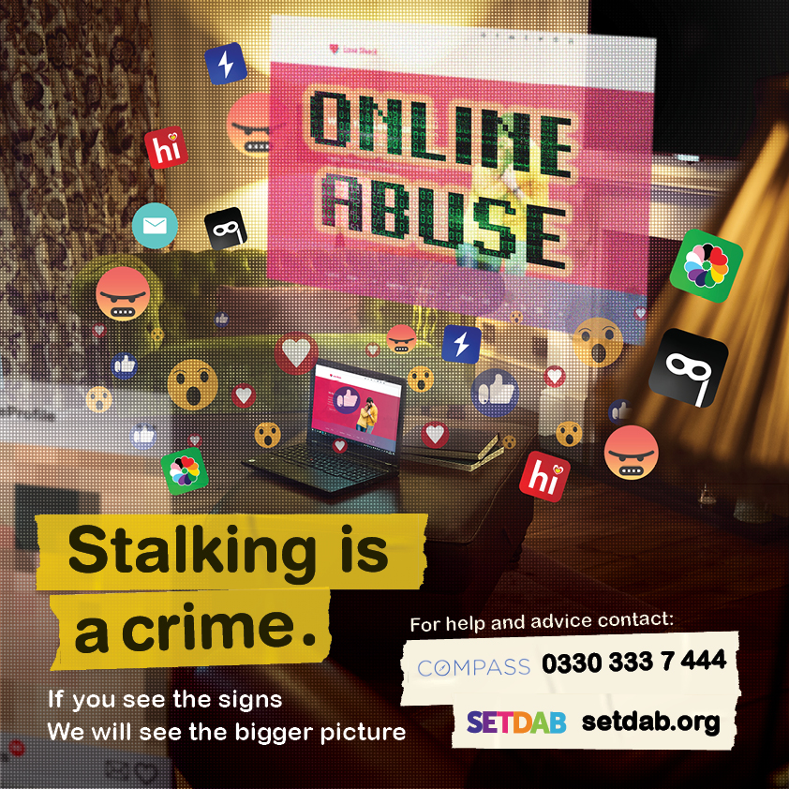
Facebook
Cyberstalking is when a person keeps track of you online or uses other electronic means to harass, scare, or threaten physical harm.
What can you do?
Be mindful of what you share online
Regularly check and update your privacy settings on social media platforms
Regularly change passwords
Keep a record, screen shot or log of calls and text messages
If you are being stalked help is available from Essex Compass, call 0330 333 7 444 or visit their website. Essex Compass
#NSAW2024 #thebiggerpicture #StalkingAwareness #stalking
Twitter/Instagram
Cyberstalking includes tracking you online to harass or threaten. Be mindful what you share online, update your privacy settings on social media, change passwords. Keep records of unwanted calls/messages.
If you are being stalked help is available from Essex Compass, call 0330 333 7 444 or visit their website. Essex Compass
#NSAW2024

Slide 4
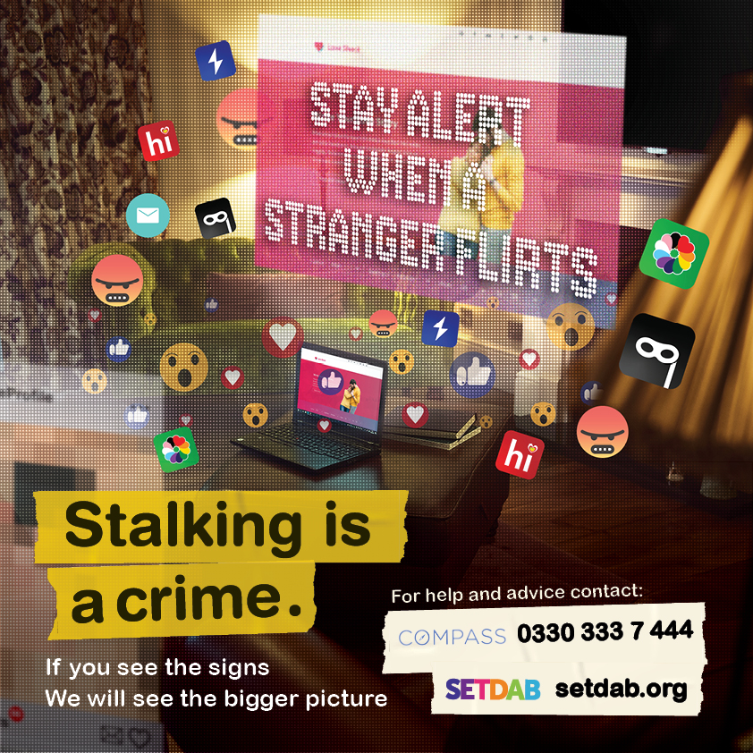
Facebook
Being afraid to check your phone, always looking over your shoulder, feeling isolated and trapped in your own home - these are some of the terrifying experiences often faced by victims of stalking.
Read Hayley's courageous story to understand how stalking affected her life.
A Stalking Case Study - Hayley’s online stalking nightmare - Southend and Thurrock Domestic Abuse Partnership (setdab.org)
Stalking is a crime, and if something doesn’t feel right, help is available from Essex Compass. Call 0330 333 7 444 or visit their website. Remember, you're not alone.
Essex Compass
In an emergency, always call 999.
#NSAW2024 #thebiggerpicture #StalkingAwareness #stalking
Twitter and Instagram
Afraid to check your phone, afraid to leave your home, always looking over your shoulder,- these are some of the terrifying experiences faced by stalking victims. Read Hayley's story to understand how stalking affected her life.
A Stalking Case Study - Hayley’s online stalking nightmare - Southend and Thurrock Domestic Abuse Partnership (setdab.org)

Slide 5
Cyberstalking can take various forms, including unauthorised access or manipulation of smart home devices, such as Alexa, heating systems or smart locks. Find out more how to protect yourself by visiting
The Cyber Helpline - Southend and Thurrock Domestic Abuse Partnership (setdab.org)
Stalking is a crime, if something doesn’t feel right, there is help available through Essex Compass, call 0330 333 7 444 or visit their website.
Essex Compass
If you are in immediate danger, always call 999.
#NSAW2024 #thebiggerpicture #StalkingAwareness #stalking

Slide 6
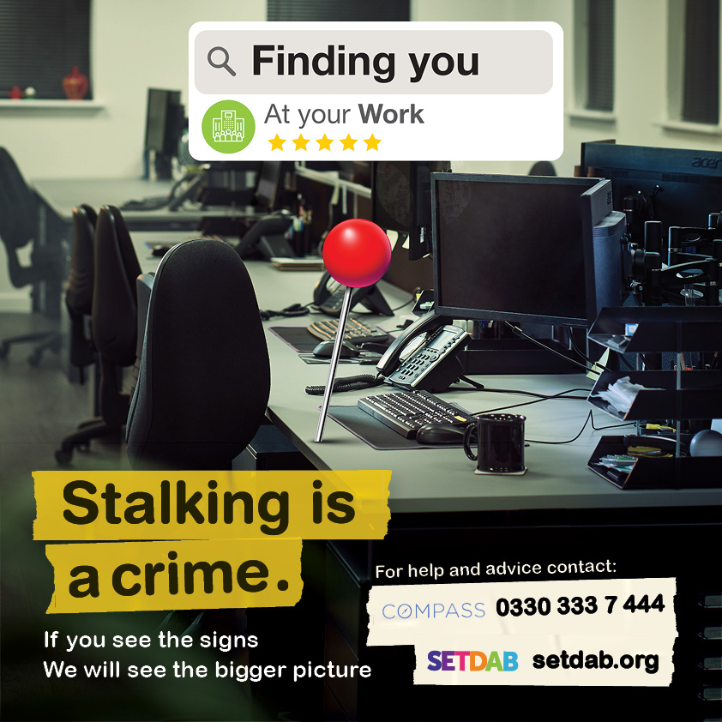
Facebook
Is your ex following you, turning up at your work, or constantly contacting you? Are you changing your usual pattern or route to work to avoid them?
Read Rosie's courageous story to understand how stalking affected her life
If you think you’re being stalked, there is help available through Essex Compass, call 0330 333 7 444 or visit their website.
Trust your instincts and get the help you need today.
#StalkingAwareness #stalking #NSAW2024 #thebiggerpicture
Twitter and Instagram
Is your ex-partner stalking you, showing up at work, or bombarding you with messages? Are you altering your routine to avoid them? .If you think you’re being stalked, there is help available through Essex Compass, call 0330 333 7 444 or visit their website.
#StalkingAwareness #stalking #NSAW2024 #thebiggerpicture

Slide 7
Facebook
Are you being bombarded with unwanted texts, emails or messages? Is the constant unwanted contact making you feel uncomfortable or frightening you? Stalking poses a real threat of harm. Trust your instincts and please reach out for help through Essex Compass, call 0330 333 7 444 or visit their website.
Essex Compass
If you are in immediate danger, always call 999.
#NSAW2024 #thebiggerpicture #StalkingAwareness #stalking
Twitter and Instagram
Are you overwhelmed by unwanted texts, emails, or messages? Feeling frightened by constant contact? You're not alone. #Stalking is a real threat. trust your instincts and get help by contacting Essex Compass,
call 0330 333 7 444

Slide 8
Facebook
Is your controlling ex-partner turning up at the same places as you such as the local bar, the supermarket, your gym or GP? Could your partner be tracking you via your phone or an apple tag.
If you think you’re being stalked, there is help available through Essex Compass, call 0330 333 7 444 or visit their website.
Trust your instincts and get the help you need today.
#NSAW2024 #thebiggerpicture #StalkingAwareness #stalking
Twitter and Instagram
Feeling like your ex-partner is everywhere you go? Whether it's the bar, supermarket, gym, or even your GP, 📱 Could they be tracking you? Trust your instincts and seek help. Contact Essex Compass at 0330 333 7 444 or visit their website.
#NSAW2024 #thebiggerpicture #StalkingAwareness #stalking

Slide 9
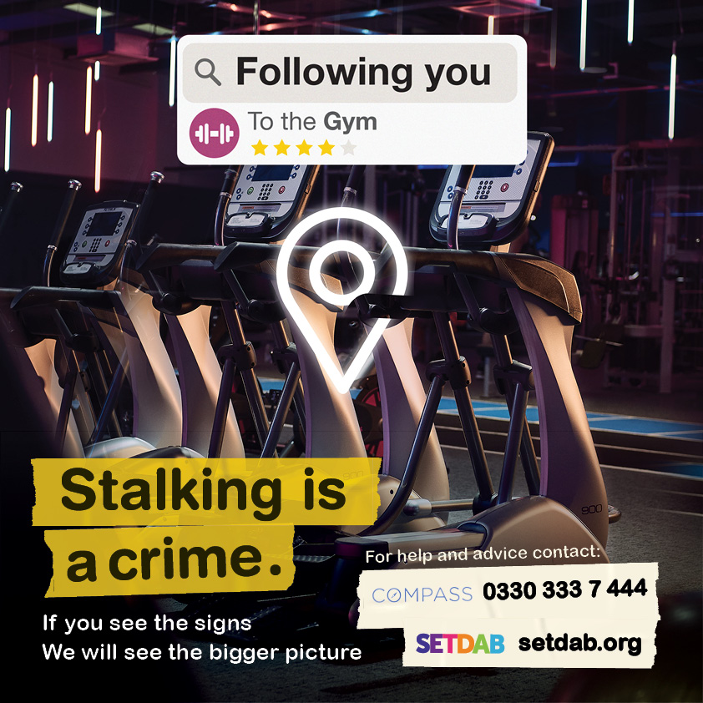
Facebook
Is your controlling ex-partner turning up at the same places as you such as the local bar, the supermarket, your gym or GP? Could your partner be tracking you via your phone or an apple tag.
If you think you’re being stalked, there is help available through Essex Compass, call 0330 333 7 444 or visit their website.
Trust your instincts and get the help you need today.
#StalkingAwareness #stalking #NSAW2024 #thebiggerpicture
Twitter and Instagram
Feeling like your ex-partner is everywhere you go? Whether it's the bar, supermarket, gym, or even your GP, 📱 Could they be tracking you? Trust your instincts and seek help. Contact Essex Compass at 0330 333 7 444 or visit their website.
#StalkingAwareness #stalking #NSAW2024 #thebiggerpicture

Slide 10
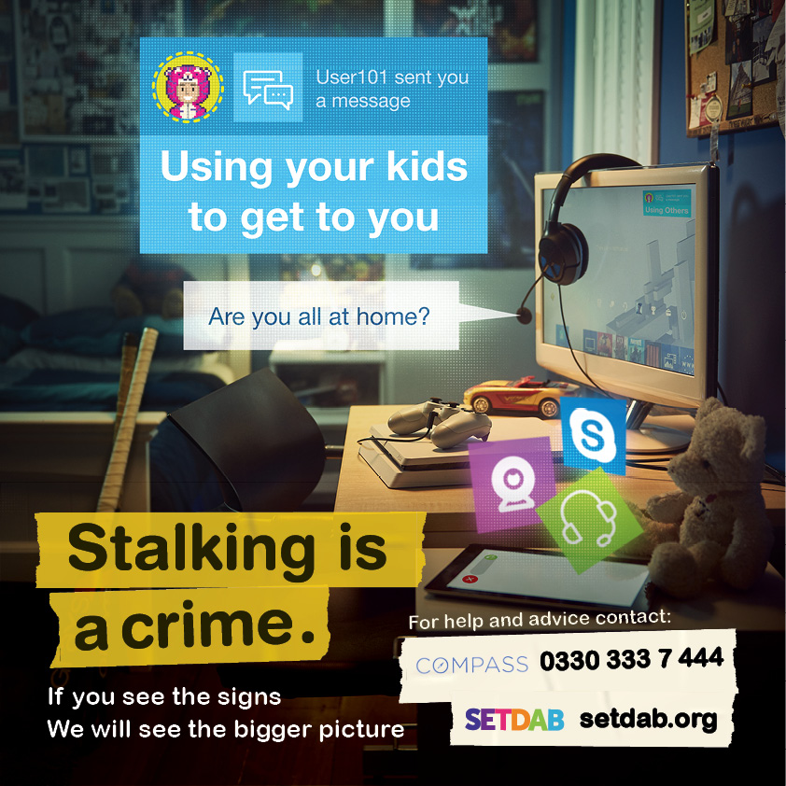
Facebook
Is your ex-partner using your kids or family members to get to you, threaten you or find out information about you? Maybe they are turning up at the school gates and using the school in some way to get to you. Is their obsessive behaviour causing you distress? Stalking can have a huge impact on you and your family.
If you think you’re being stalked, there is help available through Essex Compass, call 0330 333 7 444 or visit their website.
Trust your instincts and get the help you need today.
#StalkingAwareness #stalking #NSAW2024 #thebiggerpicture
Twitter and Instagram
Is your ex-partner involving your kids or family to intimidate you or gather information? Stalking doesn't just affect the victim—it impacts families too. Don't suffer in silence. Reach out for help today through Essex Compass, call 0330 333 7 444 or visit their website.
#StalkingAwareness #stalking #NSAW2024 #thebiggerpicture

Slide 11
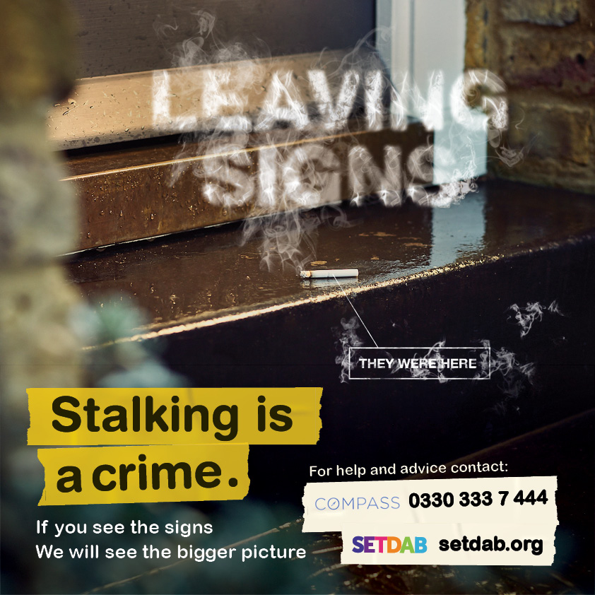
Facebook
Did you know that stalkers often leave subtle signs to let you know that they have ‘been there’, with the aim of psychologically tormenting you. The mind games and emotional abuse can lead to anxiety or depression in over 90% of victims. Don't suffer in silence.
If you suspect you're being stalked, reach out for support. Essex Compass is here to help. Call 0330 333 7 444 or visit their website for assistance. You're not alone.
#StalkingAwareness #stalking #NSAW2024 #thebiggerpicture
Twitter and Instagram
Abusers will sometimes leave signs that they have ‘been there’ to psychologically hurt you. If you need help and support visit www.setdab.org or call Changing Pathways on 01268 729707.
#StalkingAwareness #stalking #NSAW2024 #thebiggerpicture

Slide 12
Facebook
Is the damage to your property an isolated incident or is it part of a bigger picture? Unlike other crimes, which usually involve one act, stalking is a series of actions that occur over a period of time.
If you suspect you're being stalked, reach out for support. Essex Compass is here to help. Call 0330 333 7 444 or visit their website for assistance. You're not alone.
In an emergency always call 999.
#StalkingAwareness #stalking #NSAW2024 #thebiggerpicture
Twitter and Instagram
Is the damage to your property an isolated incident or is it part of a bigger picture? Unlike other crimes, which usually involve one act, stalking is an unwanted series of actions that occur over a period of time. Don't suffer in silence. Reach out for help today through Essex Compass, call 0330 333 7 444 or visit their website.
#StalkingAwareness #stalking #NSAW2024 #thebiggerpicture

Slide 13
Facebook
Are you being sent unwanted gifts? Are you receiving unwanted deliveries or abusive letters through the post? Are you feeling uneasy about the unwanted attention or feeling threatened and frightened? Stalking is a pattern of persistent and unwanted attention that makes you feel scared, anxious or harassed. For help or advice please contact Essex Compass by calling 0330 333 7 444 or visit their website for assistance. You're not alone.
#StalkingAwareness #stalking #NSAW2024 #thebiggerpicture
Twitter and Instagram
Are you being sent unwanted gifts? Are you receiving unwanted deliveries or abusive letters through the post? Stalking is a pattern of persistent and unwanted attention that makes you feel scared, anxious or harassed. For help or advice please contact Essex Compass by calling 0330 333 7 444 or visit their website.
#StalkingAwareness #stalking #NSAW2024 #thebiggerpicture
#domesticabuse #signsofstalking

Slide 14
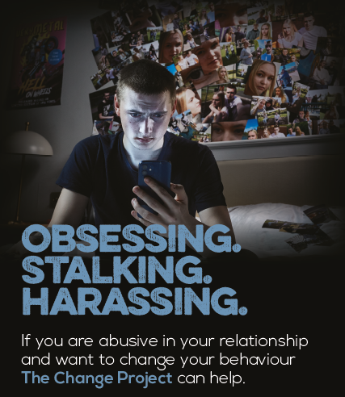
Perpetrator Focused
Platforms: Facebook
What did you get up to last night?
Did you track your partner’s movements – maybe turned up at their house when they didn’t want you there?
Maybe you sent hundreds of messages when they didn’t pick up the phone, or sent unwanted gifts to them.
If you recognise any of these signs, then it’s time to #Reflect on your behaviour and get help.
Your partner is not your property, and you can get support to stop your obsessive thoughts.
Visit The Change Project today: www.thechange-project.org
If you think you’re being stalked, there is help available through Essex Compass, call 0330 333 7 444 or visit their website.
Right click to save photo

Slide 15
Perpetrator Focused
Platforms: Twitter
What did you get up to last night?
Did you track your partner’s movements – maybe turn up at their house when they didn’t want you there?
If you recognise these signs, it’s time to #Reflect on your behaviour and get help.
Make a change today: www.thechange-project.org
If you think you’re being stalked, there is help available through Essex Compass, call 0330 333 7 444 or visit their website.

Slide 16
Perpetrator Focused
Platforms: Instagram
What did you get up to last night?
Did you track your partner’s movements – maybe turn up at their house when they didn’t want you there?
If you recognise these signs, it’s time to #Reflect on your behaviour and get help.
Make a change today: www.thechange-project.org
If you think you’re being stalked, there is help available through Essex Compass, call 0330 333 7 444 or visit their website.
#ReflectOnYourBehaviour #DomesticAbuse #DomesticAbuseAwareness #DomesticAbuseIsNotOkay #DomesticAbusePrevention #GetHelp #TheChangeProject #Counselling #Therapy #NSAW2024

