Slide 1
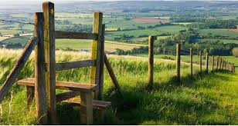
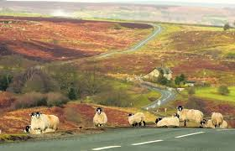



Domestic Abuse in Rural Communities
A tool for Service Providers

Slide 2
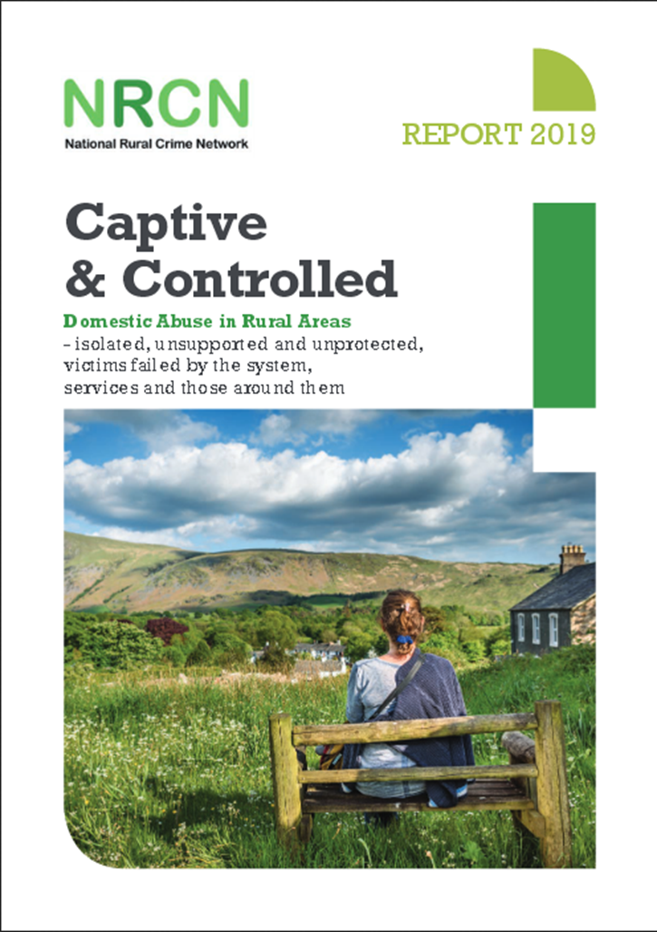
The ‘Captive and Controlled’ report launched in July 2019 by the National Rural Crime Network indicated that rural communities are less likely to get support for domestic abuse and the services that are provided are less effective than in urban areas. Therefore, as services we need to tap into rural communities in more effective ways so that victims are and feel supported.
Domestic-Abuse-in-Rural-Areas-National-Rural-Crime-Network.pdf (northyorkshire-pfcc.gov.uk)

Slide 3





The availability of public services in rural areas more generally is on the decline, limiting the support networks and escape routes available to victims.
The more rurally you live, the harder it is to get support, the less effective that support is, and therefore the greater risk and harm sits in the most isolated settings.
Abuse lasts, on average, 25 per cent longer in the most rural areas.
Men tend to hold the rural positions of power – head of the household, landowner, landlord, policeman, farmer.
Rural victims are half as likely as urban victims to report their abuse.

Slide 4


Toolkit for Reaching Rural Communities

Slide 5


To engage victims in rural communities we need to utilise local assets such as churches, pubs, vets, and GP surgeries as drop-in locations for IDVAs, DAPs and DA support services.

Slide 6
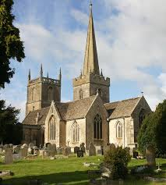
Local Churches
For local churches in Essex please click on the link below for The Church of England and East London, the Diocese of Chelmsford:
https://www.chelmsford.anglican.org/
The Diocese of Chelmsford has a Rural Advisor and Agricultural Chaplain - Revd Canon Janet Nicholls who can also be contacted for advice and support:
Tel: 01371 851317
Email: jnicholls@chelmsford.anglican.org
Website: https://www.chelmsford.anglican.org/about-us/our-faith-in-action/rural-issues

Slide 7


Local GP Surgeries
For local GP surgeries in Essex, you can contact the local ICBs (previously CCGs) which have a list of all GPs and their contact details:
Mid Essex Alliance:
Chelmsford, Maldon & Braintree – https://www.nhs.uk/services/trusts/gps/defaultview.aspx?id=89685
South-East Essex Alliance:
Southend, Castle Point & Rochford – https://www.midandsouthessex.ics.nhs.uk/health/find-your-pcn/?search=&locations_area=south-east-essex
South-West Essex Alliance:
Basildon, Brentwood – https://www.midandsouthessex.ics.nhs.uk/health/find-your-pcn/?search=&locations_area=basildon-and-brentwood
Thurrock – https://www.midandsouthessex.ics.nhs.uk/health/find-your-pcn/?search=&locations_area=thurrock
Suffolk & North-East Essex (SNEE):
Colchester & Tendring – https://www.nhs.uk/Services/Trusts/GPs/DefaultView.aspx?id=89686
Hertfordshire & West Essex:
Harlow, Saffron Walden & Uttlesford – https://westessexccg.nhs.uk/gps-and-local-services/gp-practices

Slide 8
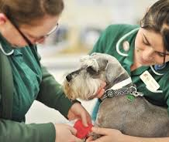

Local Veterinary Surgeries
For local Veterinary Surgeries in Essex, please click on the link below. The website provides a full list and contact details of vets across Southend, Essex, and Thurrock:
https://findavet.rcvs.org.uk/find-a-vet-practice/by-county/essex/
Local Pubs
For local pubs in Essex, you can contact the local CAMRA club for each district which have a complete list of pubs and contacts in their areas:
http://www.essex-camra.org.uk/

Slide 9

To utilise local networks such as the Women’s Institute, parish councils, young farmer association and other local groups to
educate rural communities about domestic abuse, as well as
engaging victims.

Slide 10
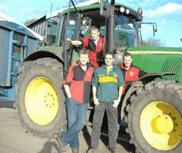

Local Networks
Women’s Institutes: For a list of all the Women’s Institutes across Essex, click on the link below:
http://www.essexwi.org.uk/find-a-wi/
Parish Councils: A list of all parish councils in Essex can be found on the Essex Highways website, and are broken down into districts: http://www.essexhighways.org/highway-scheme-and-developments/local-highway-panels/parish-and-district-contacts.aspx
Essex Young Farmers Club: Essex young Farmers Club is a youth organisation made up of 16–26-year-olds. Their website contains a wealth of information and has an online contact form. Alternatively, they can also be contacted by telephone or email:
Tel: 01245 360442
Email: office@essexyfc.co.uk
Website: http://www.essexyoungfarmers.com

Slide 11
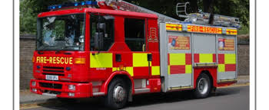
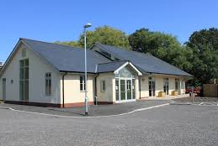
Essex Fire and Rescue Service: A complete list and map of all the stations located in Essex can be found on their website: http://www.essex-fire.gov.uk/locations/. Alternatively, you can contact them by telephone: 01376 576000 or 0300 3035555.
Village Halls: A list and map of village halls across Essex can be found on the Rural Community Council of Essex’s (RCCE) website. Their website is full of information relating to their work in communities, partnership work, community buildings, and a members area. This website could be utilised to advertise domestic abuse services and campaigns across the county. To contact the RCCE please use the details below:
Website:https://www.essexrcc.org.uk/Community_Buildings/Find_a_Village_Hall.aspx
Tel: 01376 574330
Email: enquiries@essexrcc.org.uk

Slide 12

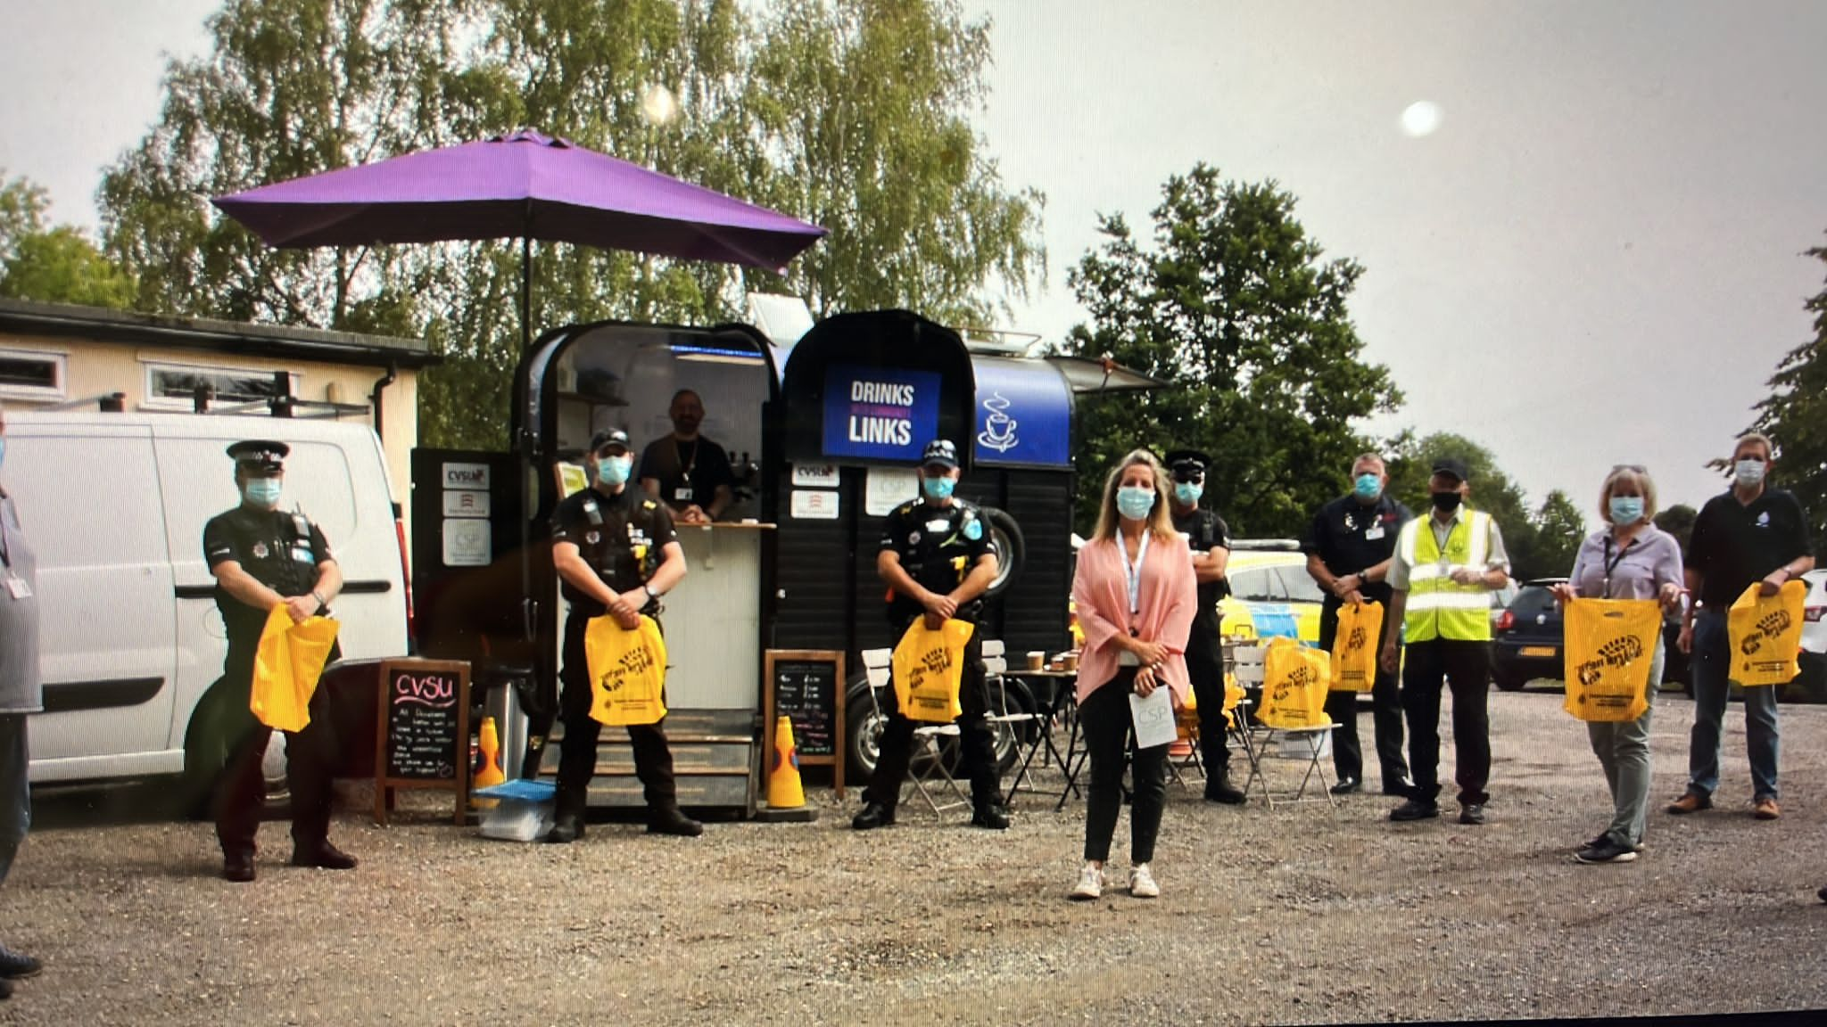

Essex Police Rural Engagement Team: Are a team dedicated to tackling rural crime. Advice and information can be found on their website: https://www.essex.police.uk/advice/advice-and-information/rc/rural-crime/
To report a non-emergency crime
Website: https://www.essex.police.uk/ro/report/ocr/af/how-to-report-a-crime/
Live Chat: use the above link, click on the blue circle in the lower right-hand corner to begin a chat.
Tel: 101
CrimeStoppers: Crimes can also be reported anonymously to CrimeStoppers.
Website: crimestoppers-uk.org
Tel: 0800 555 111
In an emergency always dial 999.

Slide 13

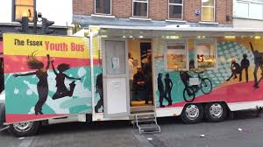
Mobile Libraries & Youth Buses
Use mobile libraries or youth buses as a method of raising awareness.
Mobile Library: The mobile Library service for Essex makes approximately 215 stops around villages and communities in Essex. For a list of all the stops and the weekly rota you can check their website:
https://libraries.essex.gov.uk/digital-content/our-mobile-and-home-library-services/mobile-libraries
Mobile Youth Bus: Essex Youth Service run the youth buses that operate in more rural areas and communities. They have a newsletter and regular updates on their website as well as their contact details:
https://youth.essex.gov.uk/community-groups/mobile-youth-delivery/

Slide 14



Advertise domestic abuse services and campaigns in rural literature such as parish notice boards, parish newsletters, church newsletters, and local leaflets.
Parish noticeboards, newsletters and church newsletters are a great way to advertise services as they are often placed in the heart of rural communities and are seen by a wide range of people.
Most parish noticeboards allow leaflets to be added ad hoc, however, some require you to contact the local parish council. This also applies for churches and other faith buildings, but for advice and approval to display service leaflets please use the links on slides 6 & 10 to contact local services.

Slide 15



Advertise domestic abuse services and campaigns in local Facebook groups.
Accessing local Facebook groups can be difficult as they can be for very small communities and vast in number. However by having your own Service Provider Facebook page you can connect with other voluntary and statutory agencies. This will help to make connections across Essex and reach more people.
Some helpful Facebook pages include:
Essex Police: https://www.facebook.com/EssexPoliceUK
Essex County Council: https://www.facebook.com/essexcountycouncil/
Southend-on-Sea City Council: https://www.facebook.com/SouthendCCOfficial/
Thurrock Borough Council: https://www.facebook.com/thurrockcouncil/
These agencies also have links to their Instagram and twitter pages which are also another great method of reaching a variety of communities.

Slide 16



Utilise rural organisations (such as Essex Rural Partnership, Essex Association of Local Councils, Farming Community Network, Essex Agricultural Society, Royal Horticultural Society, Essex Wildlife Trust) for advertising domestic abuse support services and raising awareness.
Essex Agricultural Society promote agriculture and rural industries through a year-round diary of educational and social events: https://www.essexag.co.uk/
Royal Horticultural Society hosts events nationally, but also has a number of publications that could be utilised to promote services: https://www.rhs.org.uk/about-the-rhs/contact-us
Essex Wildlife Trust host local events which include local talks, family and children and health. They could be utilised to host talks about domestic abuse: https://www.essexwt.org.uk/

Slide 17



The Essex Rural Partnership (ERP) brings together key organisations in Essex to consider, debate and act on major issues affecting the rural parts of the county. Their website is full of information and also has a rural crime strategy page: https://www.essexruralpartnership.org.uk/
The Essex Association of Local Councils (EALC) offer a wide range of services to it's affiliated members such as training, toolkits and weekly bulletins: http://www.ealc.gov.uk/about-ealc/
The Farming Community Network (FCN) is a voluntary organisation and charity that supports farmers and families within the farming community through difficult times. This includes faming, family, health and well-being: https://fcn.org.uk/

Slide 18

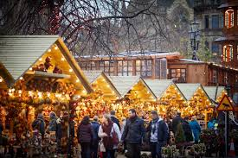
Have domestic abuse service provider presence and/or stalls at local seasonal fetes/events.
Local events are a great way of meeting local communities and advertising services. There are a number of ways to get involved either by contacting local parish councils, utilising local Facebook Groups to look out for up and coming events, as well as subscribing to local and rural organisations’ newsletters and bulletins.

Slide 19

J9 Initiative
The J9 Domestic Abuse Initiative is named in memory of Janine Mundy, who was killed by her estranged husband while he was on police bail. The initiative was started by her family and the local police in Cornwall, where she lived, and aims to raise awareness of domestic abuse and assist victims to seek the help they so desperately need.
One of the main findings from the Captive and Controlled report stated that “in depth interviews with victims and survivors revealed a consistent and telling reality – that rural communities are still dominated by men and follow a set of age-old, protected and unwritten principles.” By reaching out to rural communities with this initiative we may be able to confront, challenge and change these views.
Email: J9community@outlook.com

Slide 20


For more information you can read the full National Rural Crime Network Report:
Domestic-Abuse-in-Rural-Areas-National-Rural-Crime-Network.pdf (northyorkshire-pfcc.gov.uk)

