Slide 1
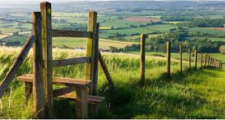
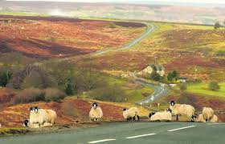
Rural Communities
A tool for Service Providers

Slide 2
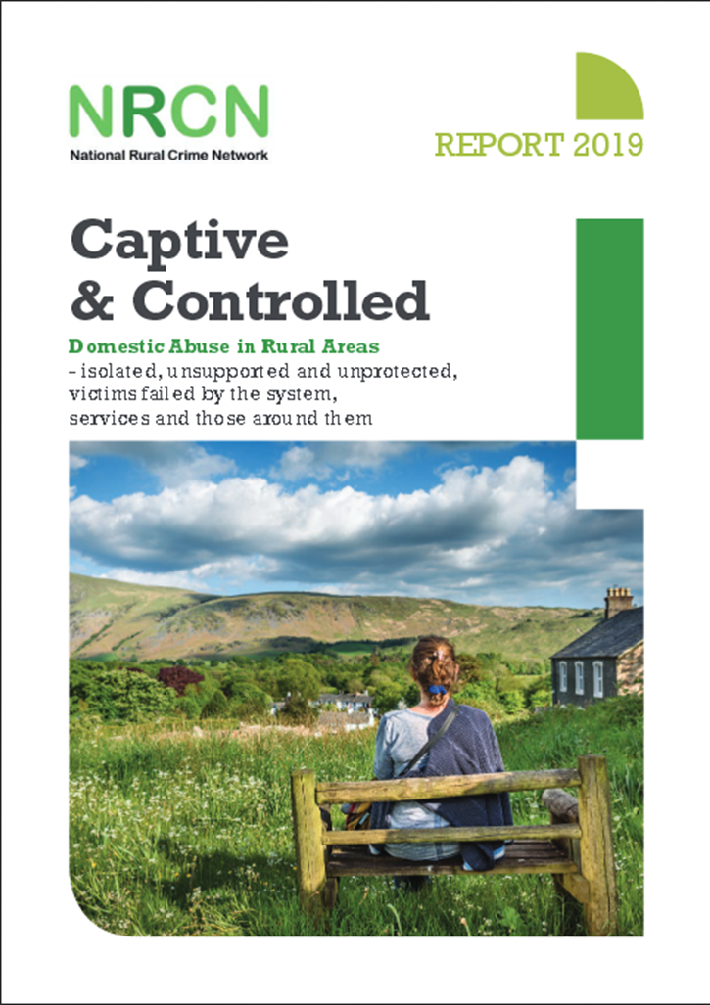
Domestic Abuse in Rural Communities
The ‘Captive and Controlled’ report launched in July 2019 by the National Rural Crime Network indicated that rural communities are less likely to get support for domestic abuse and the services that are provided are less effective than in urban areas. Therefore as services we need to tap into rural communities in more effective ways so that victims are and feel supported.
www.ruralabuse.co.uk

Slide 3
The availability of public services in rural areas more generally is on the decline, limiting the support networks and escape routes available to victims .
The more rurally you live, the harder it is to get support, the less effective that support is, and therefore the greater risk and harm sits in the most isolated settings.
Abuse lasts, on average, 25 per cent longer in the most rural areas.
Men tend to hold the rural positions of power – head of the household, land owner, landlord, policeman, farmer.
Rural victims are half as likely as urban victims to report their abuse.

Slide 4
Toolkit for Reaching Rural Communities

Slide 5
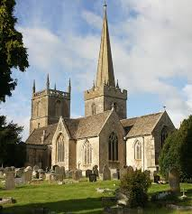
Utilise local assets such as churches, pubs, vets, GP surgeries as drop in locations for IDVAs, DAPs and DA support services to engage victims.
How to make contact:
For local churches in Essex please click on the link below for The Church of England and East London , the Diocese of Chelmsford:
https://www.chelmsford.anglican.org/
The Diocese of Chelmsford has a Rural Advisor and Agricultural Chaplain - Revd Janet Nicholls who can also be contacted for advice and support Tel: 07590929499 Email: nicholls@chelmsford.anglican.org
For local pubs in Essex you can contact the local CAMRA club for each district which have a complete list and contact for pubs in their areas:
http://www.essex-camra.org.uk/

Slide 6
For local GP Surgeries in Essex you can contact the local CCGs which have a list of all GPs and their contact details:
For Mid Essex: https://www.nhs.uk/services/trusts/gps/defaultview.aspx?id=89685
For North East Essex: https://www.nhs.uk/Services/Trusts/GPs/DefaultView.aspx?id=89686
For West Essex: https://westessexccg.nhs.uk/gps-and-local-services/gp-practices
For Southend Castlepoint and Rochford: https://southendccg.nhs.uk/your-health-services/gp-services
For Thurrock: https://www.thurrockccg.nhs.uk/your-health/where-to-go-for-your-healthcare
For Basildon and Brentwood: https://basildonandbrentwoodccg.nhs.uk/

Slide 7
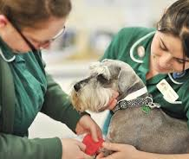
Utilise local assets such as churches, pubs, vets, GP surgeries as drop in locations for IDVAs, DAPs and DA support services to engage victims.
For local Veterinary Surgeries in Essex you can check the full list on the below link. The website provides an full list and contact details of Vets across Southend Essex and Thurrock.:
https://findavet.rcvs.org.uk/find-a-vet-practice/by-county/essex/

Slide 8
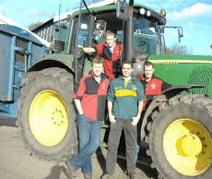
Utilise local networks such as the Women’s Institute, parish councils, young farmer association and other local groups to
educate rural communities about domestic abuse as well as
engaging victims.
For a list of all the Women’s Institutes across Essex by clicking on the link: http://www.essexwi.org.uk/find-a-wi/
For a list of all parish councils in your area can be found on the Essex Highways website and are broken down into districts: http://www.essexhighways.org/highway-scheme-and-developments/local-highway-panels/parish-and-district-contacts.aspx
Essex young Farmer’s is a youth organisation made up of 16-26 year olds. Their website http://www.essexyoungfarmers.com is a wealth of information and they can be contacted by phone: 01245 360442; email: office@essexyfc.co.uk. Alternatively you can complete an online contact form on their website.

Slide 9
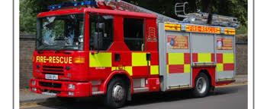
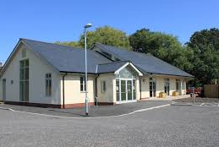
Essex Fire and Rescue Service have a complete list and map of all of the stations located in Essex. This can be found on their website: http://www.essex-fire.gov.uk/locations/ .Alternatively you can contact them directly either by an online contact form or by phone: 013676 576000 or 0300 3035555.
A list and map of village halls across Essex can be found on the Rural Community Council of Essex’s (RCCE) website at: https://www.essexrcc.org.uk/Community_Buildings/Find_a_Village_Hall.aspx
Their website is full of information relating to their work in communities; with partners; community buildings and a members area. This website could be utilised to advertise domestic abuse services and campaigns across the county, The contact details for RCCE can be found at: https://www.essexrcc.org.uk/Contact_us/Contact_us.aspx

Slide 10
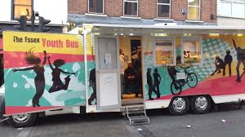
Use mobile libraries or youth buses as a method of raising awareness.
The mobile Library service for Essex makes approximately 215 stops around villages and communities in Essex. For a list of all the stops and the weekly rota you can check their website:
https://libraries.essex.gov.uk/mobile-library-service/mobile-routes-and-areas-april-2018/
Essex Youth Service run the youth buses that operate in more rural areas and communities. They have a newsletter and regular updates on their website as well as their contact details: https://youth.essex.gov.uk/get-in-touch/
For the mobile youth bus: https://youth.essex.gov.uk/community-groups/mobile-youth-delivery/

Slide 11
Advertise domestic abuse services and campaigns in rural literature such as parish notice boards, parish newsletters, church newsletters, and local leaflets.
Parish Notice Boards, newsletters and church newsletters are a great way to advertise services as they are often placed in the heart of rural communities and are seen by a wide range of people.
Most Parish noticeboards allow leaflets to be added ad hoc, however some require you to contact the local parish council. This also applies for churches and other faith buildings but for advice and approval to display service leaflets please use the links on slides 5 & 8 to contact local services.

Slide 12
Advertise domestic abuse services and campaigns in local Facebook groups.
Accessing local Facebook groups can be difficult as they can be for very small communities and vast in number. However by having your own Service Provider Facebook page you can connect with other voluntary and statutory agencies. This will help to make connections across Essex and reach more people. Some helpful Facebook pages include:
Essex Police, Essex County Council, Southend on Sea Borough Council and Thurrock Borough.
These agencies also have links to their Instagram and twitter pages which are also another great method of reaching a variety of communities.

Slide 13
Utilise rural organisations (such as Essex Rural Partnership, Essex Association of Local Councils, Farming Community Network, Essex Agricultural Society, Royal Horticultural Society, Essex Wildlife Trust) for advertising domestic abuse support services and awareness.
Essex Agricultural Society promote agriculture and rural industries through a year-round diary of educational and social events: https://www.essexag.co.uk/
Royal Horticultural Society hosts events nationally but also has a number of publications that could be utilised to promote services: https://www.rhs.org.uk/about-the-rhs/contact-us
Essex Wildlife Trust host local events which include local talks, family and children and health. They could be utilised to host talks about domestic abuse: https://www.essexwt.org.uk/

Slide 14
The Essex Rural Partnership (ERP) brings together key organisations in Essex to consider, debate and act on major issues affecting the rural parts of the county. Their website is full of information and also has a rural crime strategy page: https://www.essexruralpartnership.org.uk/
The Essex Association of Local Councils (EALC) offer a wide range of services to it's affiliated members such as training, toolkits and weekly bulletins: http://www.ealc.gov.uk/about-ealc/
The Farming Community Network (FCN) is a voluntary organisation and charity that supports farmers and families within the farming community through difficult times. This includes faming, family, health and well-being: https://fcn.org.uk/

Slide 15
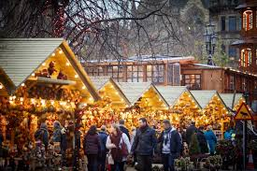
Have domestic abuse service provider presence and/or stalls at local seasonal fetes/events etc.
Local events are a great way of meeting local communities and advertising services. There are a number of ways to get involved wither by contacting local parish councils, utilising local Facebook Groups to look out for up and coming events as well as subscribing to local and rural organisation’s newsletters and bulletins.

Slide 16
Consideration of implementing the J9 initiative in more rural settings.
The J9 Domestic Abuse Initiative is named in memory of Janine Mundy, who was killed by her estranged husband while he was on Police bail. The initiative was started by her family and the local police in Cornwall, where she lived and aims to raise awareness of domestic abuse and assist victims to seek the help they so desperately need.
One of the main findings from the Captive and Controlled report stated that “In depth interviews with victims and survivors revealed a consistent and telling reality – that rural communities are still dominated by men and follow a set of age-old, protected and unwritten principles”. By reaching out to this community with this initiative we may be able to confront, challenge and change these views.
J9 contact details: J9community@outlook.com

Slide 17
For more information you can read the full National Rural Crime Network Report:
https://www.ruralabuse.co.uk/

